Slide 1
6.852: Distributed Algorithms Fall, 2015
Lecture 23

Slide 2
Today’s plan
Finish Paxos
Failure detectors
Readings:
[Chandra, Toueg] Unreliable Failure Detectors for Reliable Distributed Systems
[Cornejo, Lynch, Sastry] Asynchronous FDs, TR 2013-025
[Pike, Song, Sastry] Dining philosophers using FDs
[Sastry, Pike, Welch] Weakest FD for Wait-Free Dining Philosophers
[Chandra, Hadzilacos, Toueg] Weakest FD for Consensus
[Lynch, Sastry] Weakest Asynchronous FD for Consensus
Next time:
Self-stabilization
Reading: Dolev book, Chapter 2

Slide 3

Paxos consensus algorithm
Guarantees agreement, validity in all cases.
Guarantees termination if the system eventually stabilizes:
No more failures, recoveries, message losses.
Timing within “normal” bounds.
Terminates soon after system stabilizes.

Slide 4
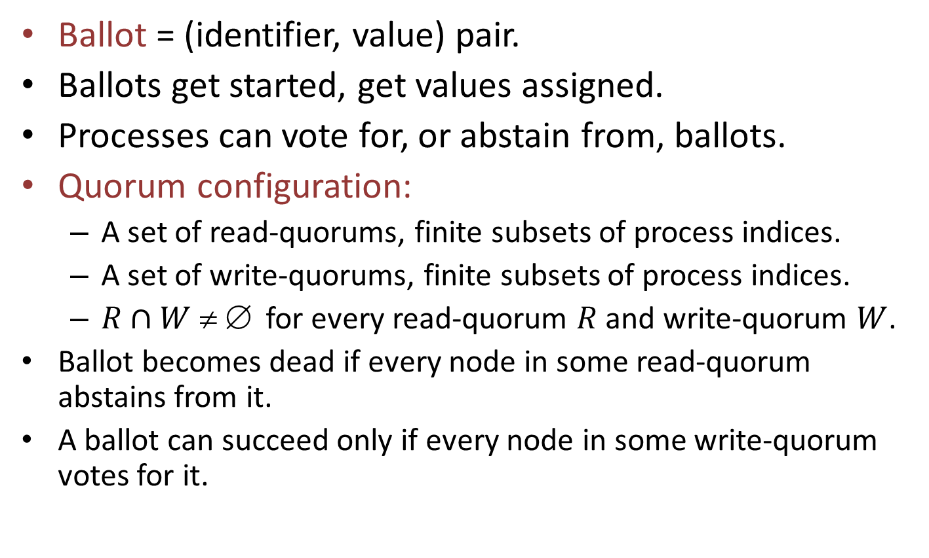
Ballots and Quorums
Ballot = (identifier, value) pair.
Ballots get started, get values assigned.
Processes can vote for, or abstain from, ballots.
Quorum configuration:
A set of read-quorums, finite subsets of process indices.
A set of write-quorums, finite subsets of process indices.
$R∩W  $ for every read-quorum $R$ and write-quorum $W$.
Ballot becomes dead if every node in some read-quorum abstains from it.
A ballot can succeed only if every node in some write-quorum votes for it.

Slide 5
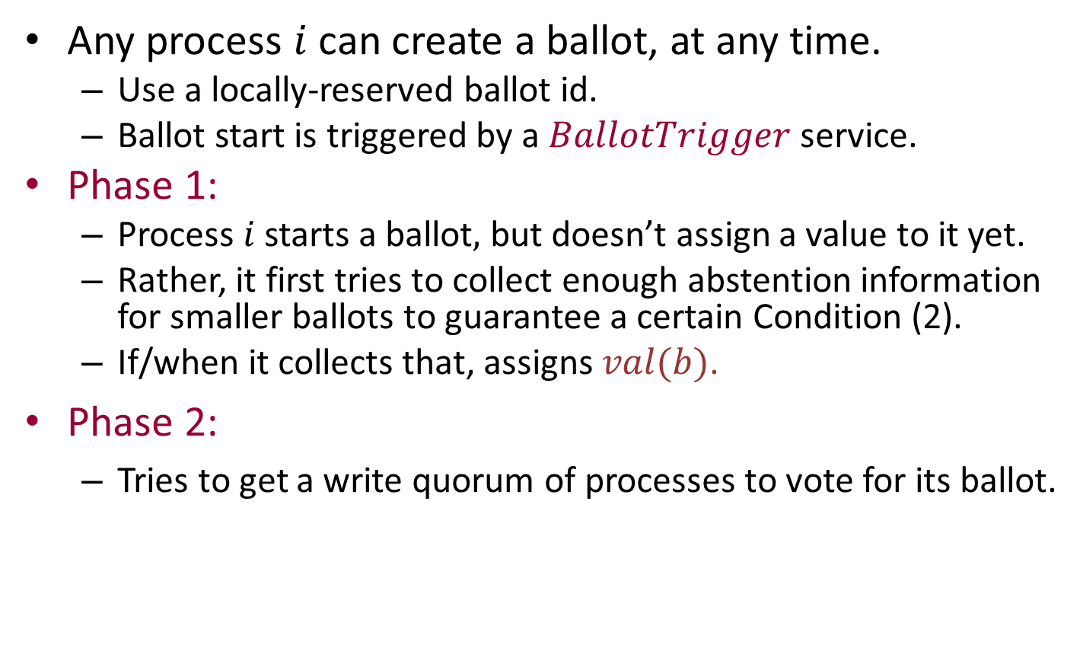
Safe algorithm
Any process $i$ can create a ballot, at any time.
Use a locally-reserved ballot id.
Ballot start is triggered by a $BallotTrigger$ service.
Phase 1:
Process $i$ starts a ballot$,$ but doesn’t assign a value to it yet.
Rather, it first tries to collect enough abstention information for smaller ballots to guarantee a certain Condition (2).
If/when it collects that, assigns $val(b)$.
Phase 2:
Tries to get a write quorum of processes to vote for its ballot.

Slide 6
Communication Pattern
make-ballot
Phase 1, collect abstention information
assign-val
Phase 2, collect votes
succeed

Slide 7
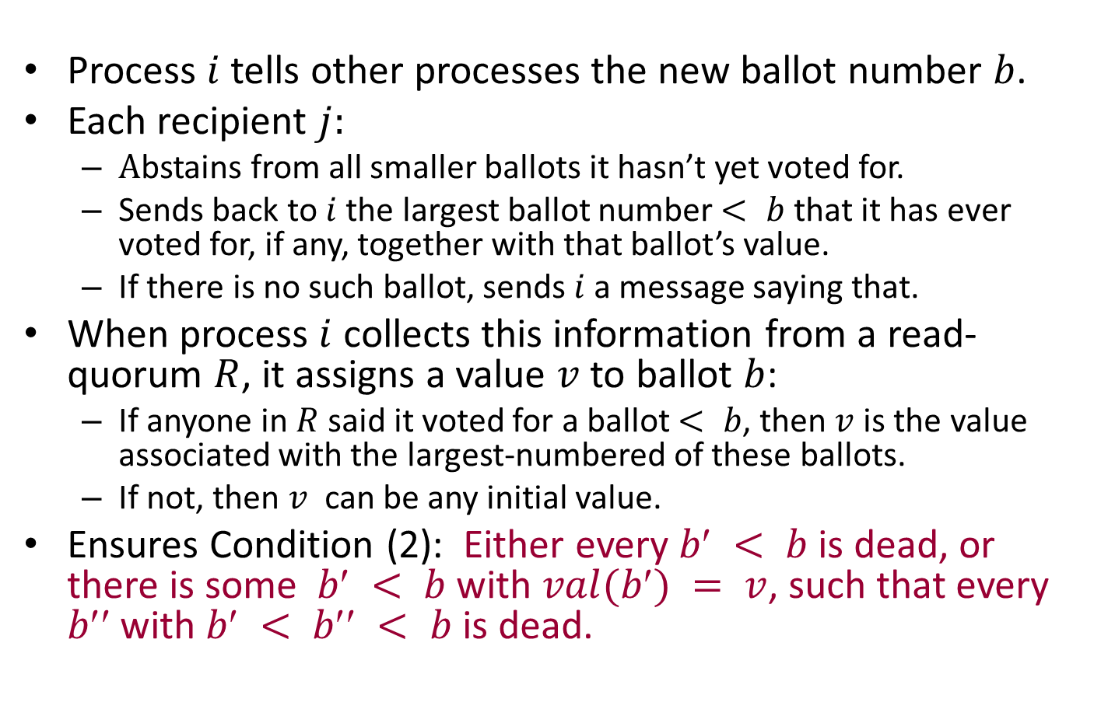
Phase 1
Process $i$tells other processes the new ballot number $b$.
Each recipient $j:$
$A$bstains from all smaller ballots it hasn’t yet voted for.
Sends back to $i$the largest ballot number $< b$ that it has ever voted for, if any, together with that ballot’s value.
If there is no such ballot, sends $i$a message saying that.
When process $i$ collects this information from a read-quorum $R$, it assigns a value $v$ to ballot $b$:
If anyone in $R$ said it voted for a ballot $< b$, then $v$is the value associated with the largest-numbered of these ballots.
If not, then $v$ can be any initial value.
Ensures Condition (2): Either every $b < b$is dead, or there is some $b < b$with $val(b) = v$, such that every $b$with $b < b < b$is dead.
Notes:
This is expanding the details of what happens in Phase 1.

Slide 8
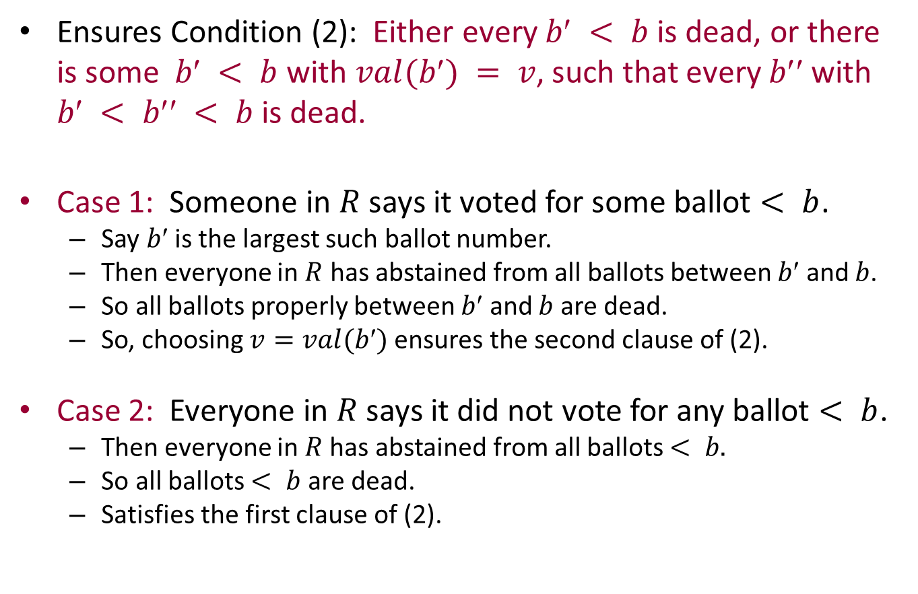
Phase 1
Ensures Condition (2): Either every $b < b$is dead, or there is some $b < b$with $val(b) = v$, such that every $b$with $b < b < b$is dead.
Case 1: Someone in $R$ says it voted for some ballot $< b$.
Say $b$is the largest such ballot number.
Then everyone in $R$ has abstained from all ballots between $b$ and $b$.
So all ballots properly between $b$ and $b$ are dead.
So, choosing $v=val(b)$ensures the second clause of (2).
Case 2: Everyone in $R$ says it did not vote for any ballot $< b$.
Then everyone in $R$has abstained from all ballots $< b.$
So all ballots $< b$ are dead.
Satisfies the first clause of (2).

Slide 9
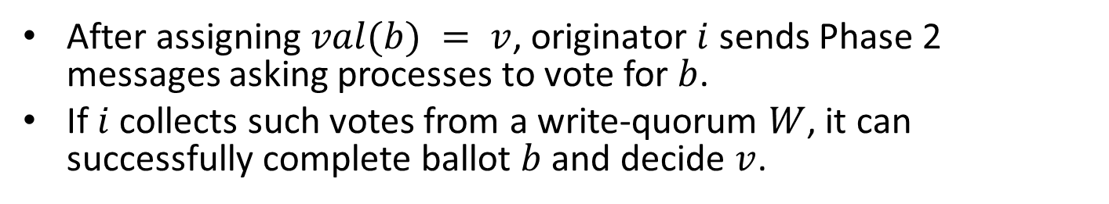
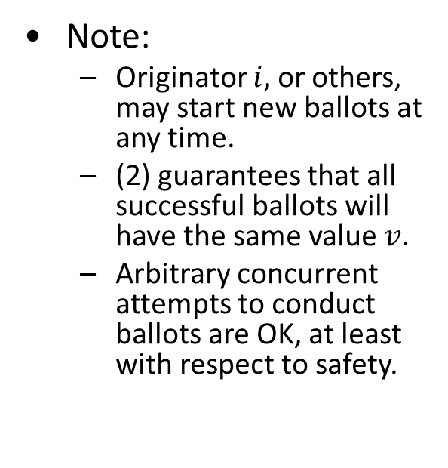
Phase 2
After assigning $val(b) = v$, originator $i$ sends Phase 2 messages asking processes to vote for $b$.
If $i$ collects such votes from a write-quorum $W$, it can successfully complete ballot $b$ and decide $v$.
Note:
Originator $i,$ or others, may start new ballots at any time.
(2) guarantees that all successful ballots will have the same value $v.$
Arbitrary concurrent attempts to conduct ballots are OK, at least with respect to safety.
make-ballot
Phase 1,
collect abstentions
assign-val
Phase 2,
collect votes
succeed
Notes:
In Phase 2, the process writes to a write quorum.
This ensures that any later attempt will see, in its first phase, at least one process that voted for this ballot, and so will take this ballot into account in assigning its own value.
This ballot cannot be dead, since a read-quorum could not abstain from it after a write-quorum has voted for it.
Once the originator of the ballot decides, it can inform the others of the decision.

Slide 10
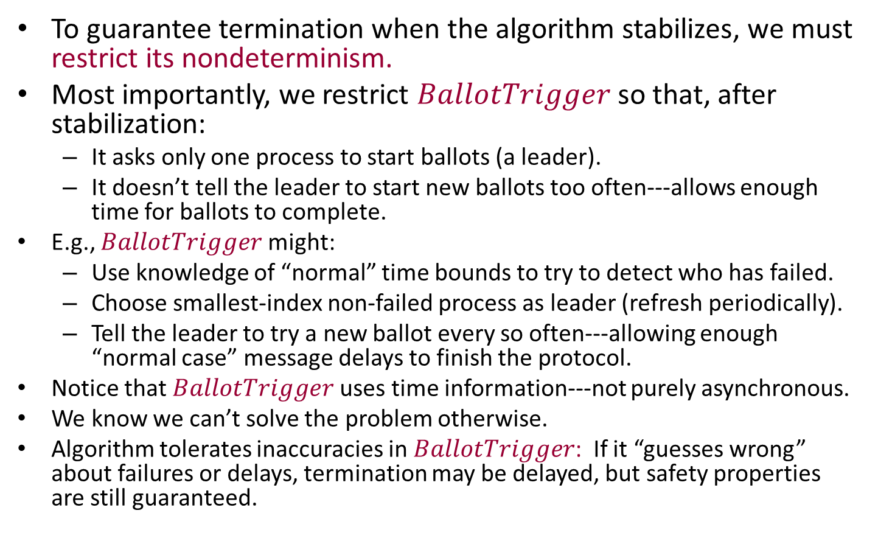
Live version of the algorithm
To guarantee termination when the algorithm stabilizes, we must restrict its nondeterminism.
Most importantly, we restrict $BallotTrigger$ so that, after stabilization:
It asks only one process to start ballots (a leader).
It doesn’t tell the leader to start new ballots too often---allows enough time for ballots to complete.
E.g., $BallotTrigger$might:
Use knowledge of “normal” time bounds to try to detect who has failed.
Choose smallest-index non-failed process as leader (refresh periodically).
Tell the leader to try a new ballot every so often---allowing enough “normal case” message delays to finish the protocol.
Notice that $BallotTrigger$uses time information---not purely asynchronous.
We know we can’t solve the problem otherwise.
Algorithm tolerates inaccuracies in $BallotTrigger$: If it “guesses wrong” about failures or delays, termination may be delayed, but safety properties are still guaranteed.
Notes:
There are other things to do to guarantee liveness.
For example, we should specify that processes don’t abstain for no reason, but only when they already know of a larger-numbered ballot.
And we should insist that all processes actually respond to all phase 1 and phase 2 messages.
The coordinator shouldn’t abandon a ballot unless it hears that someone has abstained from it.
----------
And we should have the originator of a ballot inform the others when it reaches a decision.
This is guaranteed to terminate if the system is “stable” for long enough: no failures and recoveries, and timing within normal bounds.

Slide 11
Using Paxos to emulate general shared memory in a network
Paxos paper suggests using the Paxos consensus algorithm repeatedly, to agree on successive operations on a shared data object, of any type.
Idea is similar to Herlihy’s universal construction.
Uses Replicated State Machines (RSM).
Emulates shared atomic objects that tolerate stopping failures and recoveries, message loss and duplication.
Paper also includes various optimizations, LTTR.
Considerable follow-on work, engineering Paxos to work for maintaining real data.
Disk Paxos
HP, Microsoft, Google,…

Slide 12
Failure Detectors
1
2
n
Failure
Detector
Channels

Slide 13
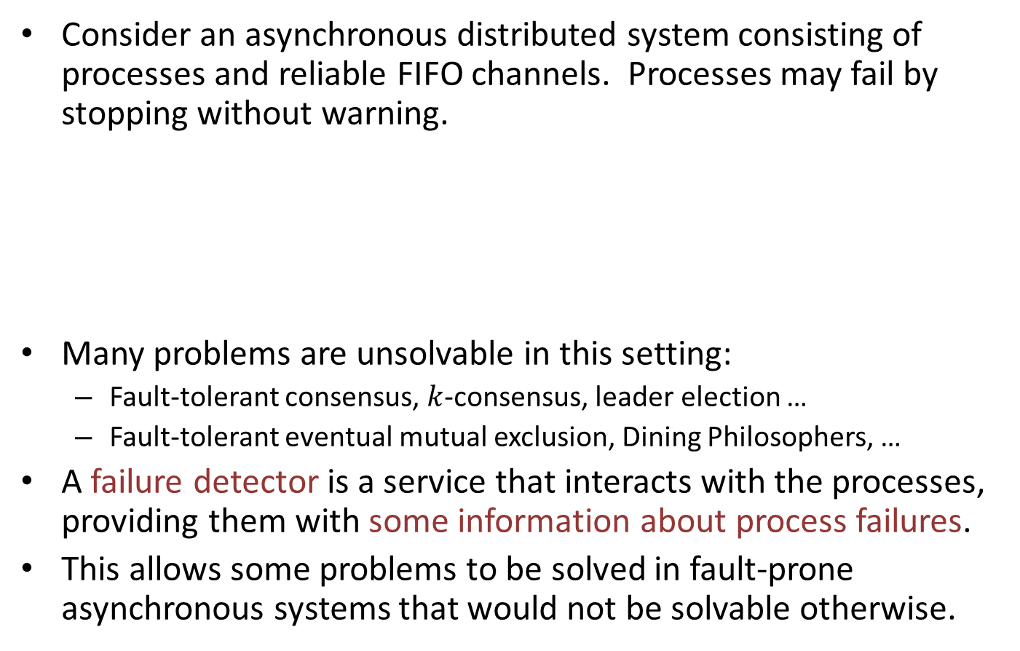
What is a failure detector?
Consider an asynchronous distributed system consisting of processes and reliable FIFO channels. Processes may fail by stopping without warning.
Many problems are unsolvable in this setting:
Fault-tolerant consensus, $k$-consensus, leader election …
Fault-tolerant eventual mutual exclusion, Dining Philosophers, …
A failure detector is a service that interacts with the processes, providing them with some information about process failures.
This allows some problems to be solved in fault-prone asynchronous systems that would not be solvable otherwise.
1
2
n
Failure
Detector
Channels
Notes:
Many fundamental problems are unsolvable in asynchronous systems with crash failures.
K-consensus is unsolvable if the number of failures is at least k.
This is because, in asynchronous systems, processes can be arbitrarily slow, and messages can be arbitrarily delayed.
So a process that has failed by stopping is indistinguishable from a slow process, or one whose messages are slow.
So failure detection is problematic.

Slide 14
Failure Detectors can be Unreliable
1
2
n
Failure
Detector
Channels
FDs provide information about which processes have failed.
The information may be unreliable:
False negative mistakes: Failure detector might not report that some failed process has failed.
False positive mistakes: Might report incorrectly that some non-failed process has failed.
Might provide different information to different processes.
Might provide different information at different times.
In spite of this unreliability, FDs can be used to solve many problems in fault-prone systems.
Notes:
The simplest kind of FDs simply output information to different processes about which other processes it currently believes to have crashed.
False negative mistakes - Like a fire alarm not going off when this is a fire.
False positive mistakes - Like a fire alarm going off when there is no fire.
Different info at different times could be contradictory, e.g., if the FD reports that some process has failed and then later corrects itself to say that it hasn’t.

Slide 15
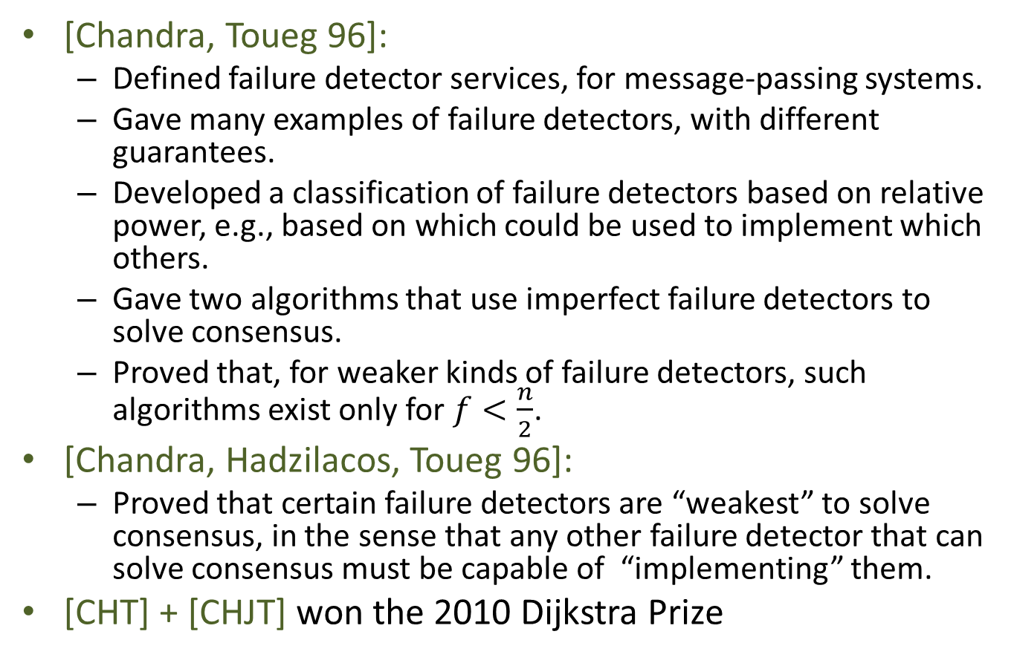
History
[Chandra, Toueg 96]:
Defined failure detector services, for message-passing systems.
Gave many examples of failure detectors, with different guarantees.
Developed a classification of failure detectors based on relative power, e.g., based on which could be used to implement which others.
Gave two algorithms that use imperfect failure detectors to solve consensus.
Proved that, for weaker kinds of failure detectors, such algorithms exist only for $f<\frac{n}{2}$.
[Chandra, Hadzilacos, Toueg 96]:
Proved that certain failure detectors are “weakest” to solve consensus, in the sense that any other failure detector that can solve consensus must be capable of “implementing” them.
[CHT] + [CHJT] won the 2010 Dijkstra Prize
Notes:
These papers were actually developed over several years before 96.

Slide 16
History
[CT], [CHT] models include:
A mixture of synchronous/timed/asynchronous aspects.
A query-response interface.
Led to oddities, e.g.:
Not every FD can “implement” itself.
FDs can convey information about aspects of executions other than failures.
Not based on a general concurrency theory foundation.
[Cornejo, Lynch, Sastry 13]:
Recast the FD definitions purely asynchronously, in terms of I/O automata.
FDs send information to processes spontaneously, no queries.
Simpler; supports a more complete formal presentation.
Removes oddities.
Yields some new results about weakest failure detectors.
Notes:
The models are not based on a general concurrency theory foundation such as I/O automata.
So they can’t rely on general results about composition and levels of abstraction, but must prove these from scratch when needed.
They don’t include all the details, probably because they are too complicated in their mixed setting and because they don’t want to re-prove basic foundational properties.
The gaps don’t seem to get in the way of understanding the easier results, but they are problematic for understanding when we get to the most difficult results, esp. the results saying that certain FDs are weakest for solving consensus.

Slide 17
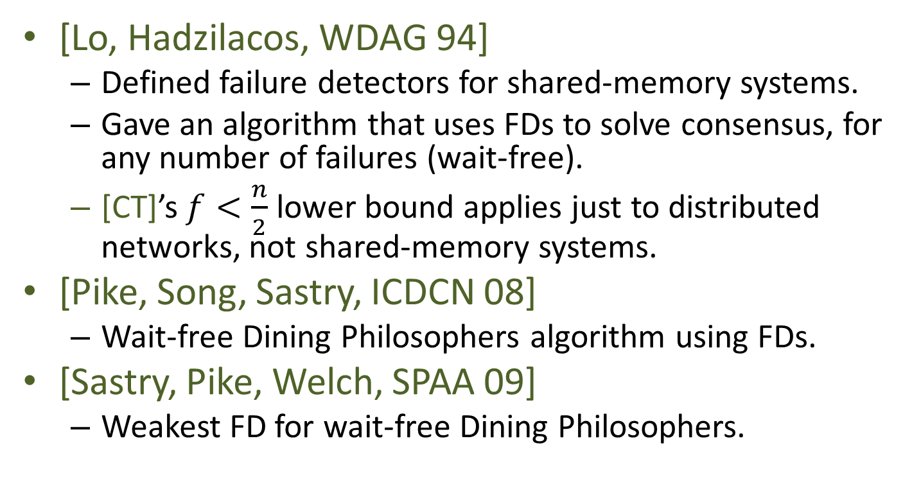
History, cont’d
[Lo, Hadzilacos, WDAG 94]
Defined failure detectors for shared-memory systems.
Gave an algorithm that uses FDs to solve consensus, for any number of failures (wait-free).
[CT]’s $f<\frac{n}{2}$ lower bound applies just to distributed networks, not shared-memory systems.
[Pike, Song, Sastry, ICDCN 08]
Wait-free Dining Philosophers algorithm using FDs.
[Sastry, Pike, Welch, SPAA 09]
Weakest FD for wait-free Dining Philosophers.
Notes:
PSS, SPW, are for message-passing.
These papers are just some highlights. It’s a fairly large literature by now.
See Sastry’s thesis and other papers for a variety of FDs for different problems.

Slide 18
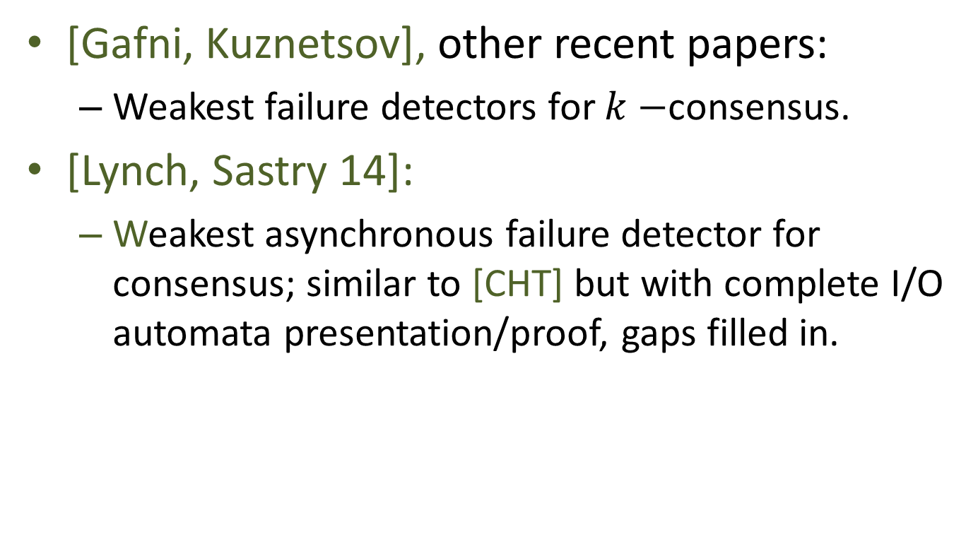
History
[Gafni, Kuznetsov], other recent papers:
Weakest failure detectors for $k−$consensus.
[Lynch, Sastry 14]:
Weakest asynchronous failure detector for consensus; similar to [CHT] but with complete I/O automata presentation/proof, gaps filled in.
1
2
n
Failure
Detector
Channels

Slide 19
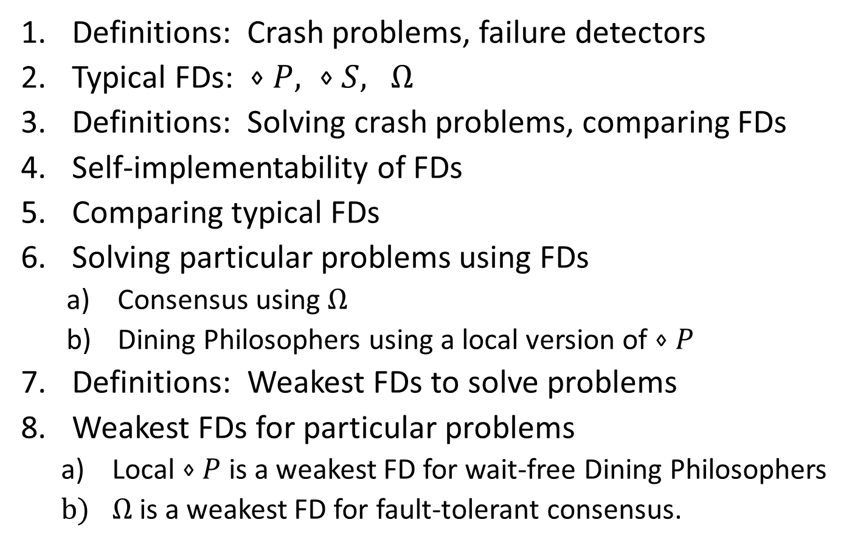
Overview
Definitions: Crash problems, failure detectors
Typical FDs: $⋄P, ⋄S,$ $Ω$
Definitions: Solving crash problems, comparing FDs
Self-implementability of FDs
Comparing typical FDs
Solving particular problems using FDs
Consensus using $Ω$
Dining Philosophers using a local version of $⋄P$
Definitions: Weakest FDs to solve problems
Weakest FDs for particular problems
Local $⋄P$ is a weakest FD for wait-free Dining Philosophers
$Ω$is a weakest FD for fault-tolerant consensus.
Notes:
Last year, this was two lectures. So this year I’ll speak at a higher level, leave out many details.

Slide 20
1. Definitions: Crash Problems and Failure Detectors
1
2
n
Failure
Detector
Channels

Slide 21
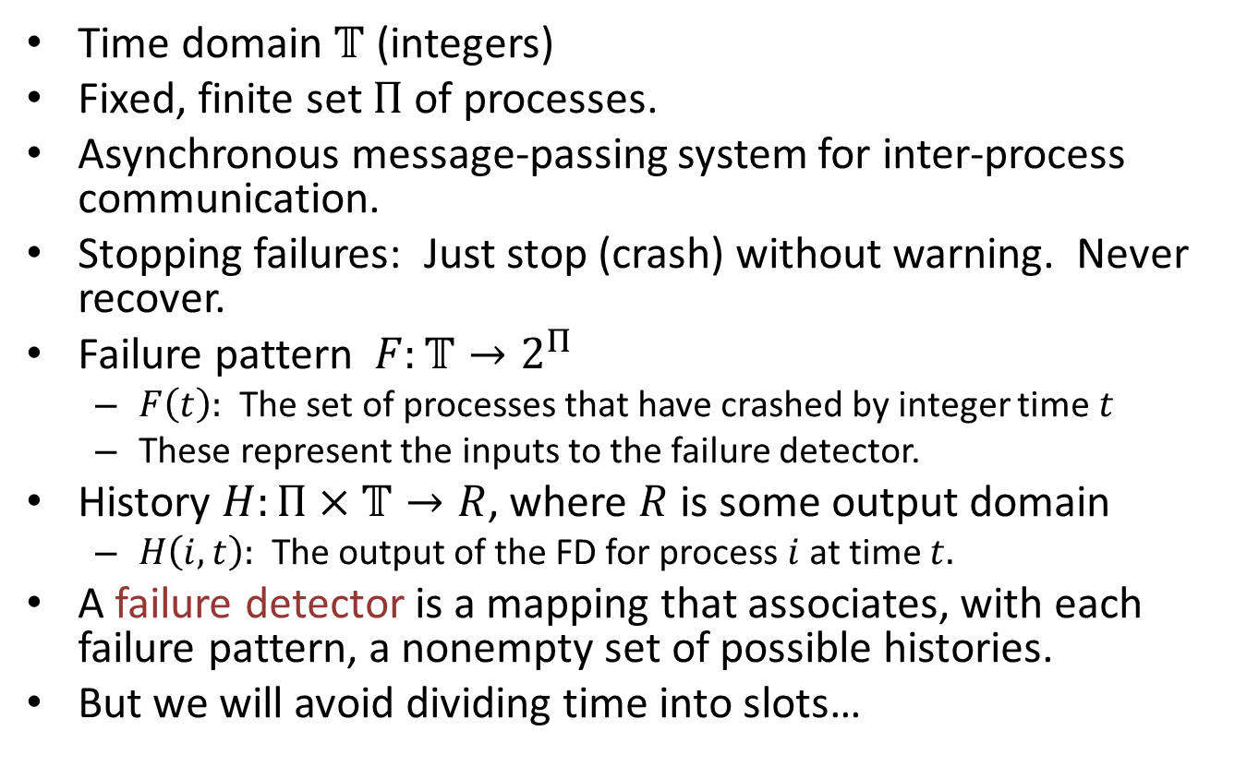
[Chandra, Toueg] definitions
Time domain $𝕋$ (integers)
Fixed, finite set $Π$ of processes.
Asynchronous message-passing system for inter-process communication.
Stopping failures: Just stop (crash) without warning. Never recover.
Failure pattern $F:𝕋→2^{Π}$
$F\left(t\right):$ The set of processes that have crashed by integer time $t$
These represent the inputs to the failure detector.
History $H:Π×𝕋→R$, where $R$ is some output domain
$H\left(i,t\right):$ The output of the FD for process $i$ at time $t.$
A failure detector is a mapping that associates, with each failure pattern, a nonempty set of possible histories.
But we will avoid dividing time into slots…
Notes:
Time is divided into synchronous slots.
Failure pattern is supposed to capture the times of actual process crashes.
They are rounded off into integer slots, however. It’s not clear why.
The output domain R is allowed to be anything. Not necessarily just announcements of who has failed as I suggested in an earlier slide.
…
We will work from the [Cornejo, Lynch, Sastry] version.

Slide 22
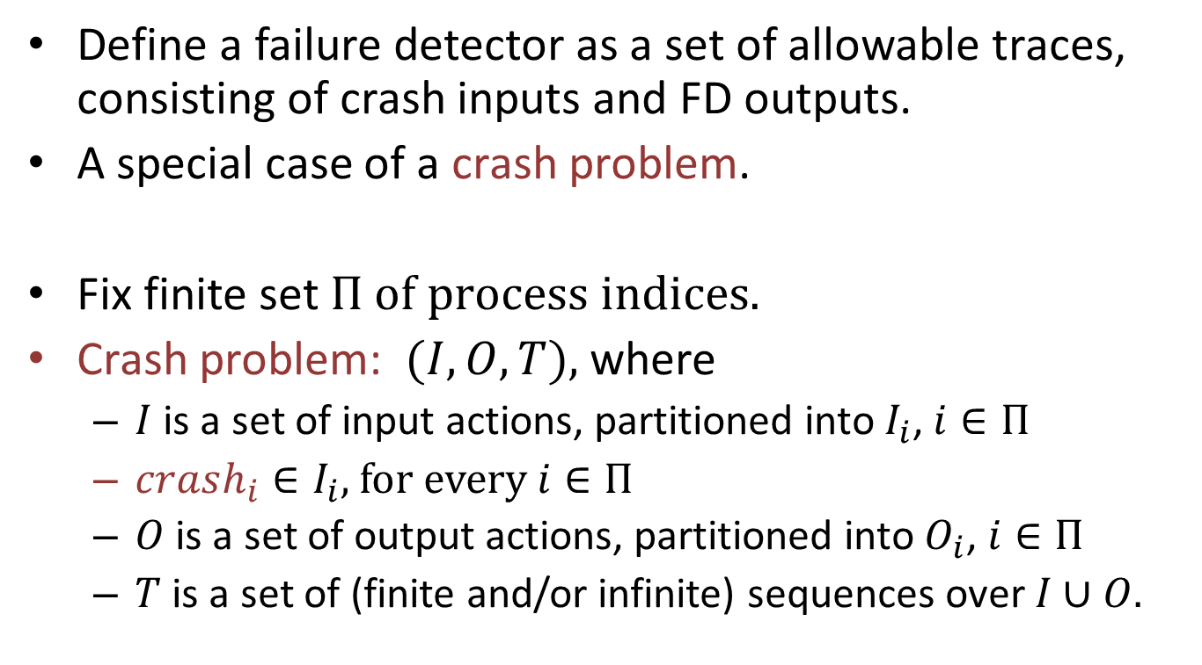
Crash Problems
Define a failure detector as a set of allowable traces, consisting of crash inputs and FD outputs.
A special case of a crash problem.
Fix finite set $Π of process indices.$
Crash problem: $(I,O,T),$where
$I$ is a set of input actions, partitioned into $I_{i}$, $i∈Π$
$crash_{i}∈I_{i}$, for every $i∈Π$
$O$ is a set of output actions, partitioned into $O_{i}$, $i∈Π$
$T$ is a set of (finite and/or infinite) sequences over $I∪O.$
Crash
Problem
Notes:
We will define a failure detector to be a special kind of “crash problem”, so we define crash problems first.
A crash problem is just a set of sequences of inputs and outputs; think of them as arising from some I/O automaton but that doesn’t have to be the case---we can define more general problems.
The notion of a crash problem depends on having locations. All inputs and outputs occur at locations.
Moreover, crashes are inputs to the problem. The problem can be defined in terms of responses to crashes.
We defined consensus and atomic object problems in this general style (in the paper, the definitions are stated in terms of a particular environment, or class of environments).
The set T is designed to capture liveness as well as safety properties.

Slide 23
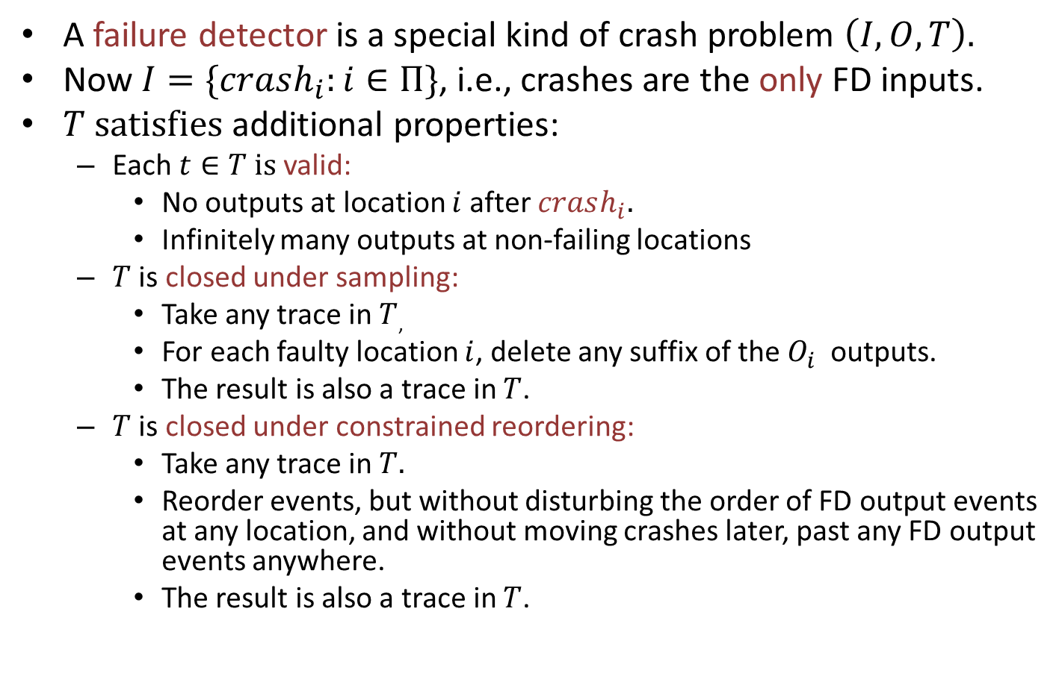
(Asynchronous) Failure Detectors
A failure detector is a special kind of crash problem $\left(I,O,T\right).$
Now $I=\{crash_{i}:i∈Π\}$, i.e., crashes are the only FD inputs.
$T satisfies$ additional properties:
Each $t∈T is$valid:
No outputs at location $i$after $crash_{i}.$
Infinitely many outputs at non-failing locations
$T$ is closed under sampling:
Take any trace in $T$,
For each faulty location $i$, delete any suffix of the $O_{i}$outputs.
The result is also a trace in $T$.
$T$ is closed under constrained reordering:
Take any trace in $T.$
Reorder events, but without disturbing the order of FD output events at any location, and without moving crashes later, past any FD output events anywhere.
The result is also a trace in $T$.
Notes:
Since the crashes are the only inputs, we can say that the FD provides information only about failures.
For closure under sampling, we may also delete any crashes except for the first (extra crashes), as well as any suffix of the outputs.
For constrained reordering: This is the version of the definition from our later WAFD paper.
The version in the original AFD paper says that we can’t disturb the order of ANY events at a location, and we can’t move a crash later past ANY other event. The results in the earlier paper should hold with either definition, but the later paper requires the less restrictive definition.
In other words, move some FD outputs later, but without reordering them with respect to any other events at the same location.
One implication of this is that FD outputs are allowed to depend on the occurrence of crashes, but not on the fact that crashes HAVE NOT occurred.

Slide 24
Remarks
Straightforward asynchronous formulation, I/O automata style.
FD defined simply as a problem, in terms of allowable sequences of input and output events.
Constraints are simple, and are just what is needed for basic results.
These are implicit in the earlier papers.

Slide 25
2. Examples: Typical Failure Detectors
1
2
n
Failure
Detector
Channels

Slide 26
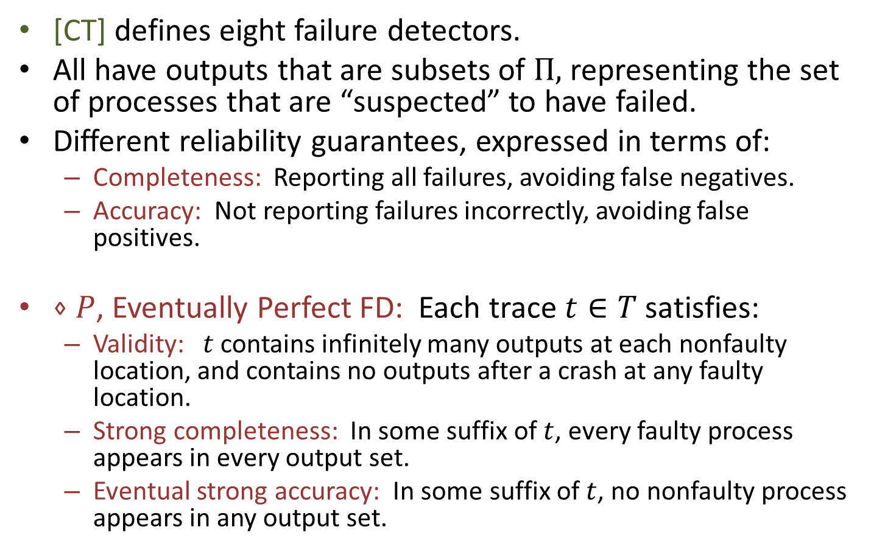
Failure Detector Examples
[CT] defines eight failure detectors.
All have outputs that are subsets of $Π,$representing the set of processes that are “suspected” to have failed.
Different reliability guarantees, expressed in terms of:
Completeness: Reporting all failures, avoiding false negatives.
Accuracy: Not reporting failures incorrectly, avoiding false positives.
$⋄P$, Eventually Perfect FD: Each trace $t∈T$ satisfies:
Validity: $t$contains infinitely many outputs at each nonfaulty location, and contains no outputs after a crash at any faulty location.
Strong completeness: In some suffix of $t$, every faulty process appears in every output set.
Eventual strong accuracy: In some suffix of $t$, no nonfaulty process appears in any output set.
Notes:
I’ll give just two examples here.
The validity conditions I list here are just the general ones that are required for crash problems.
Diamond means “eventually”.
A common type of unreliability that is considered is to say that the good properties hold eventually. We (and the processes using the FD) don’t know when, but they start holding from some point.
Technicality: A trace in T could be finite, but (because of validity) only in the case when everyone fails. Then the last two properties are true for any valid sequence, based on the empty suffix. That is what we want here.
Another way of expressing Diamond-P:
In some suffix of t, we get the exact set of nonfaulty processes (those that never fail in t).

Slide 27
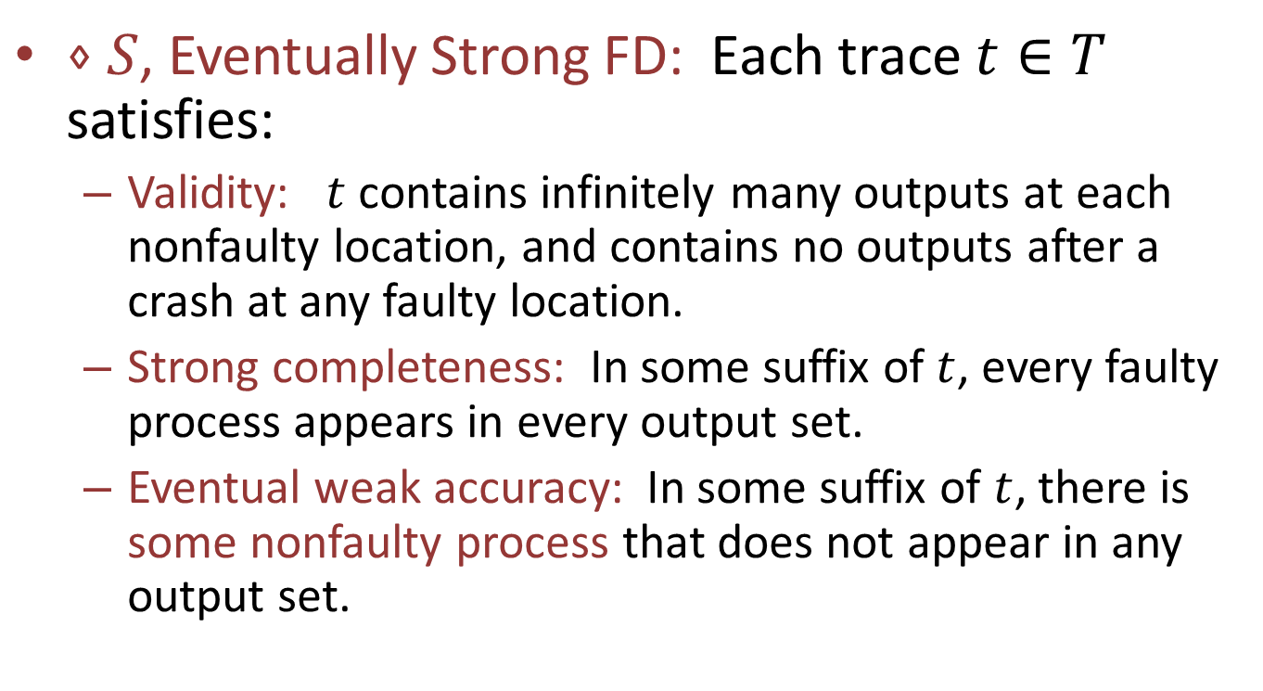
Failure Detector Examples
$⋄S$, Eventually Strong FD: Each trace $t∈T$ satisfies:
Validity: $t$contains infinitely many outputs at each nonfaulty location, and contains no outputs after a crash at any faulty location.
Strong completeness: In some suffix of $t$, every faulty process appears in every output set.
Eventual weak accuracy: In some suffix of $t$, there is some nonfaulty process that does not appear in any output set.
Notes:
What is different here from the previous case is only the accuracy property, eventual weak adversary.
The name is confusing---”weak” accuracy is part of the definition of “eventually strong” FD. But that’s what it is. Well, “strong”, is weaker than “perfect”.

Slide 28
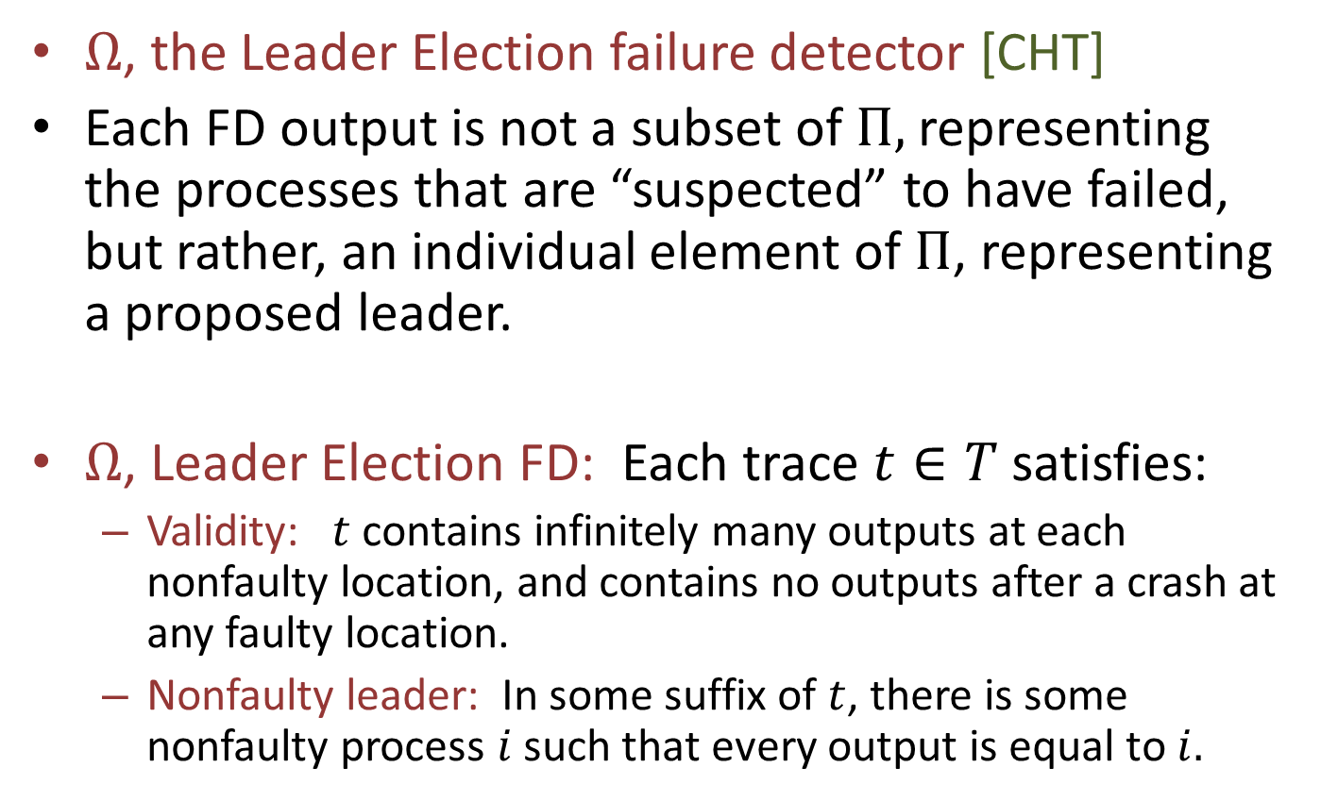
Failure Detector Examples
$Ω$, the Leader Election failure detector [CHT]
Each FD output is not a subset of $Π,$representing the processes that are “suspected” to have failed, but rather, an individual element of $Π$, representing a proposed leader.
$Ω$, Leader Election FD: Each trace $t∈T$ satisfies:
Validity: $t$contains infinitely many outputs at each nonfaulty location, and contains no outputs after a crash at any faulty location.
Nonfaulty leader: In some suffix of $t$, there is some nonfaulty process $i$ such that every output is equal to $i.$
Notes:
This one isn’t from CT, but from CHT.
Omega eventually outputs the same process name everywhere. It must be a nonfaulty process. We call that the leader.

Slide 29
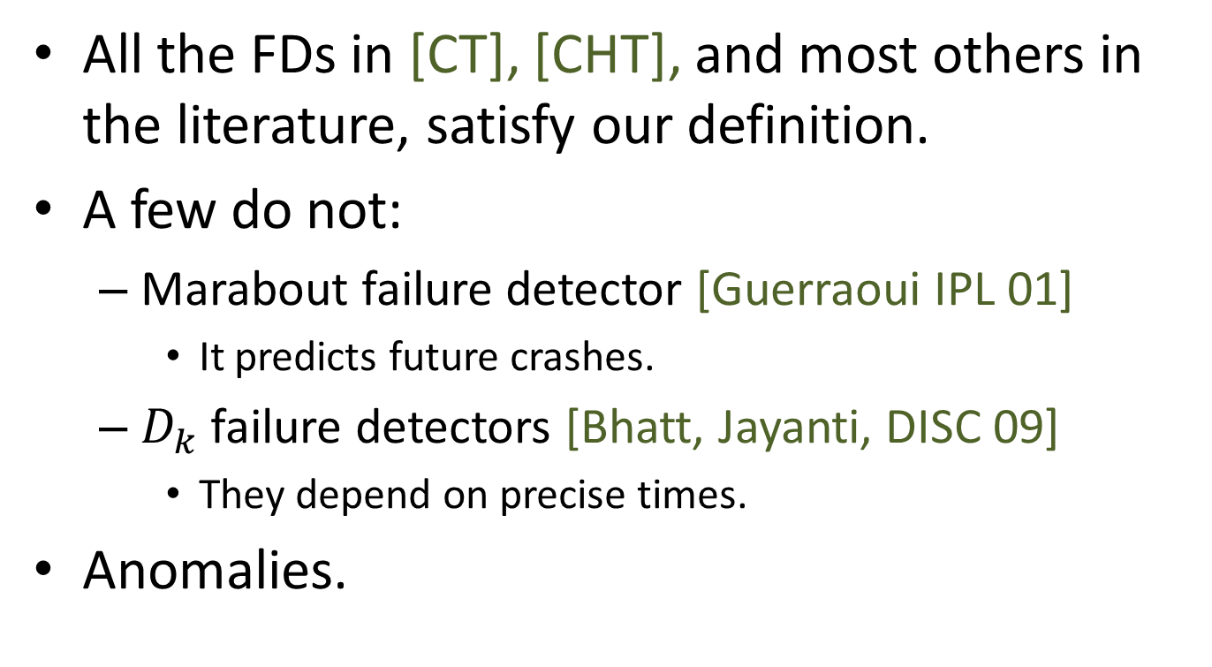
Remarks
All the FDs in [CT], [CHT], and most others in the literature, satisfy our definition.
A few do not:
Marabout failure detector [Guerraoui IPL 01]
It predicts future crashes.
$D_{k}$ failure detectors [Bhatt, Jayanti, DISC 09]
They depend on precise times.
Anomalies.
Notes:
These are formally “failure detectors” according to the CT definitions, but they seem like oddities. Our definitions exclude them.
Any failure detector that insists that the FD must output info about a crash as soon as it happens could not satisfy our definition.
Marabout means a certain kind of Muslim leader, in some parts of Africa. Rachid Guerraoui is from Rabat, Morocco.

Slide 30
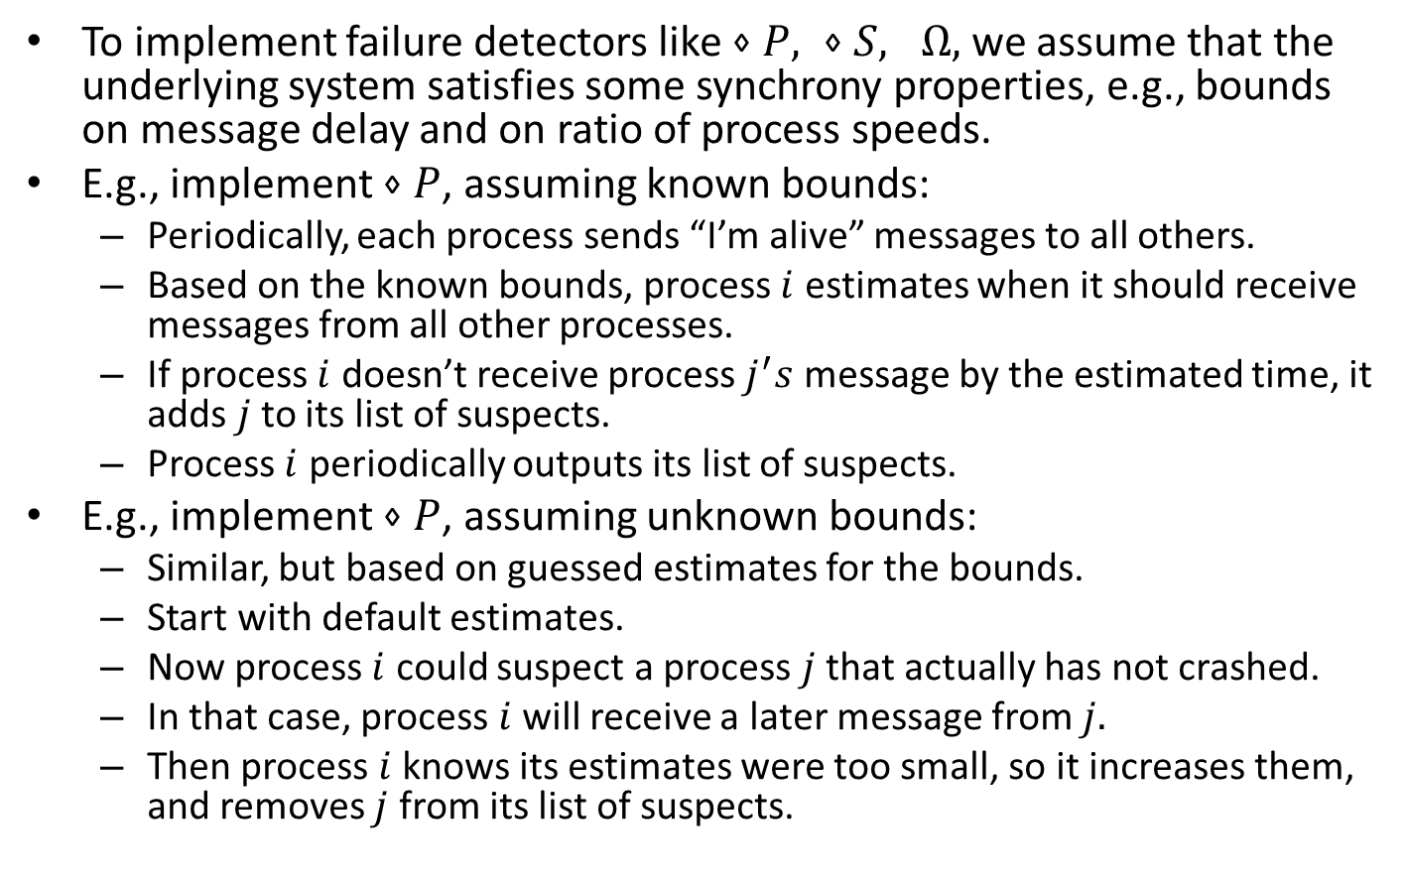
Implementing Failure Detectors
To implement failure detectors like $⋄P, ⋄S, Ω,$we assume that the underlying system satisfies some synchrony properties, e.g., bounds on message delay and on ratio of process speeds.
E.g., implement $⋄P$, assuming known bounds:
Periodically, each process sends “I’m alive” messages to all others.
Based on the known bounds, process $i$ estimates when it should receive messages from all other processes.
If process $i$ doesn’t receive process $j^{′}s$ message by the estimated time, it adds $j$to its list of suspects.
Process $i$ periodically outputs its list of suspects.
E.g., implement $⋄P$, assuming unknown bounds:
Similar, but based on guessed estimates for the bounds.
Start with default estimates.
Now process $i$ could suspect a process $j$that actually has not crashed.
In that case, process $i$ will receive a later message from $j.$
Then process $i$ knows its estimates were too small, so it increases them, and removes $j$ from its list of suspects.
Notes:
We must assume some such properties, because such FDs cannot be implemented in a purely asynchronous system.
One way to see that this is true is that these can be used to solve fault-tolerant consensus, which we know cannot be solved in asynchronous systems.

Slide 31
3. Definitions: Solving Crash Problems and Comparing Failure Detectors
1
2
n
Channels

Slide 32
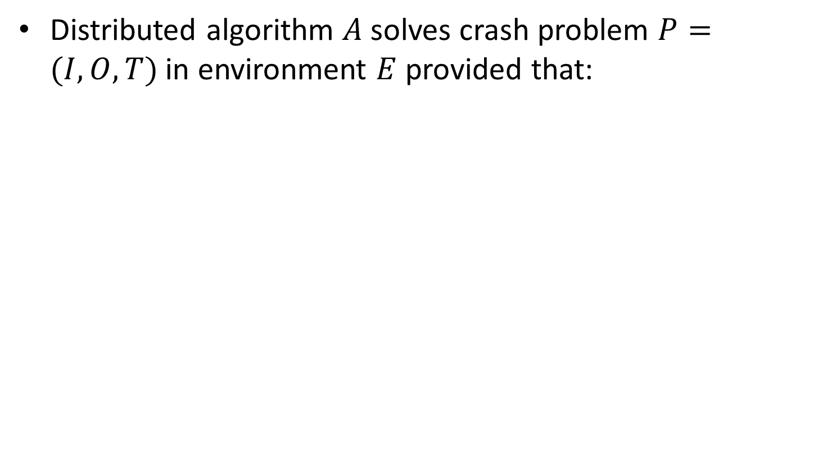
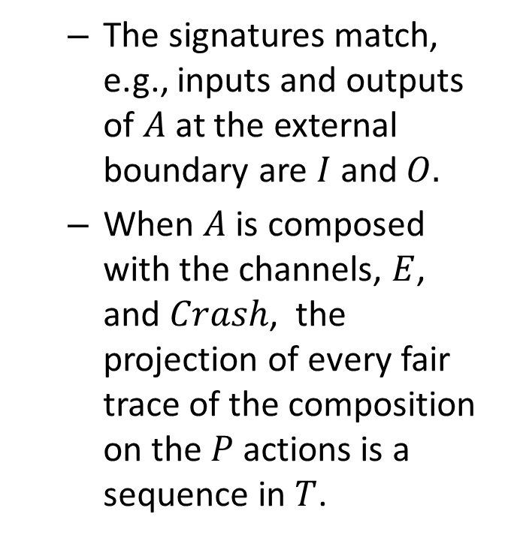
Solving a Crash Problem
Distributed algorithm $A$solves crash problem $P=(I,O,T)$ in environment $E$ provided that:
The signatures match, e.g., inputs and outputs of $A$ at the external boundary are $I$ and $O.$
When $A$is composed with the channels, $E$, and $Crash$, the projection of every fair trace of the composition on the $P$actions is a sequence in $T$.
Environment
Crash
1
2
n
Channels
Notes:
We start by defining simply what it means for a distributed algorithm to solve a crash problem.
We consider a system consisting of an algorithm and channels, interacting with an environment as usual.
We model the crash events as coming from some special external source, which we call the “Crash Automaton”. We don’t really need to do this---we could just make them inputs to the entire system.
The Crash automaton generates (arbitrary) crash events, which go to the appropriate processes and also the environment.
The signatures must match up as follows: Inputs to the algorithm = crashes and outputs of Env (which are P inputs), plus message receives.
Outputs of the algorithm = inputs to Env (which are P outputs), plus message sends.

Slide 33
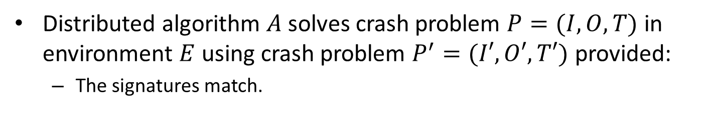
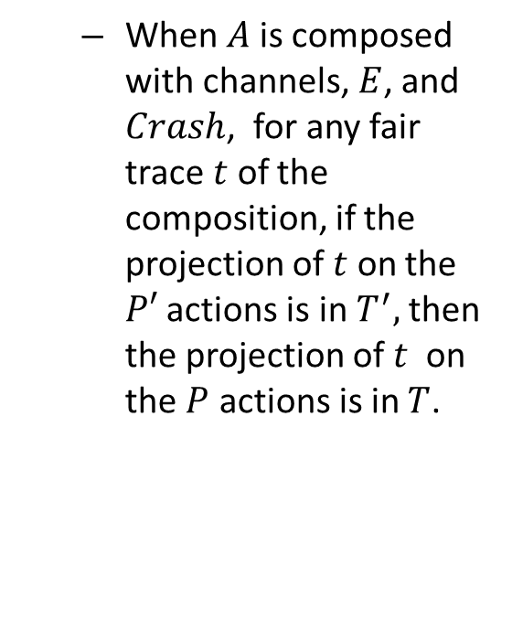
Solving One Crash Problem Using Another
Distributed algorithm $A$solves crash problem $P=(I,O,T)$ in environment $E$ using crash problem $P^{′}=(I′,O′,T′)$ provided:
The signatures match.
When $A$is composed with channels, $E$, and $Crash$, for any fair trace $t$ of the composition, if the projection of $t$ on the $P′$ actions is in $T^{′},$then the projection of $t$ on the $P$ actions is in $T$.
Environment
Crash
1
2
n
P’
Channels
Notes:
Now add the P’ service. It’s modeled as a problem (interface and set of behaviors), not necessarily an automaton.
Actually, the arrows between P’ and the algorithm components could go both ways. Usually we will consider P’ to be a FD, which has only outputs. But that isn’t the only possibility.
The Crash automaton generates (arbitrary) crash events, which go to the appropriate processes and the environment, as before, and also now to the lower-level problem P’. P’ can also depends on failures, e.g., it can be an FD.
The signatures now must match up as follows:
Inputs to the algorithm = crashes, outputs of Env (which are P inputs), and outputs of P’ (plus message receives).
Outputs of the algorithm = inputs to Env (which are P outputs) and inputs to P’ (plus message sends).

Slide 34
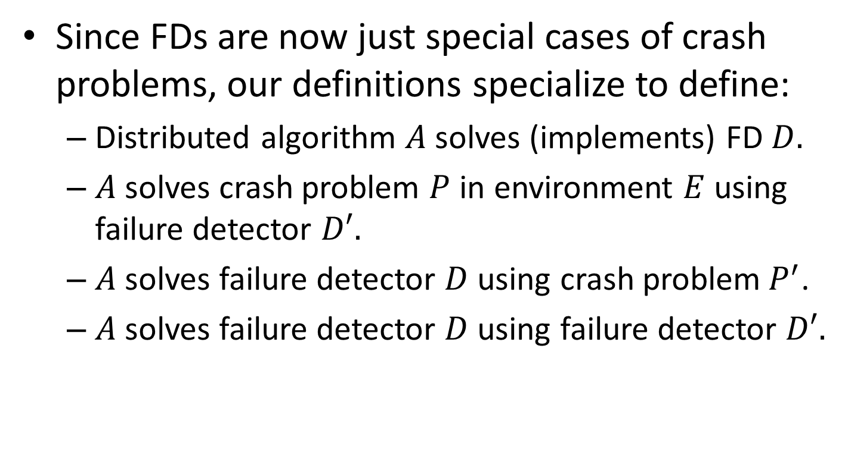
Specializing to Failure Detectors
Since FDs are now just special cases of crash problems, our definitions specialize to define:
Distributed algorithm $A$solves (implements) FD $D.$
$A$solves crash problem $P$ in environment $E$ using failure detector $D′.$
$A$solves failure detector $D$using crash problem${ P}^{′}$.
$A$solves failure detector $D$using failure detector $D′.$
Notes:
First bullet:
To implement an FD, the environment is irrelevant since the FD has no input actions other than crashes. So we can omit mention of the environment.
----------
Remark:
In all these problems, the crashes are included in the input actions. So the problems explicitly specify responses to failures.

Slide 35
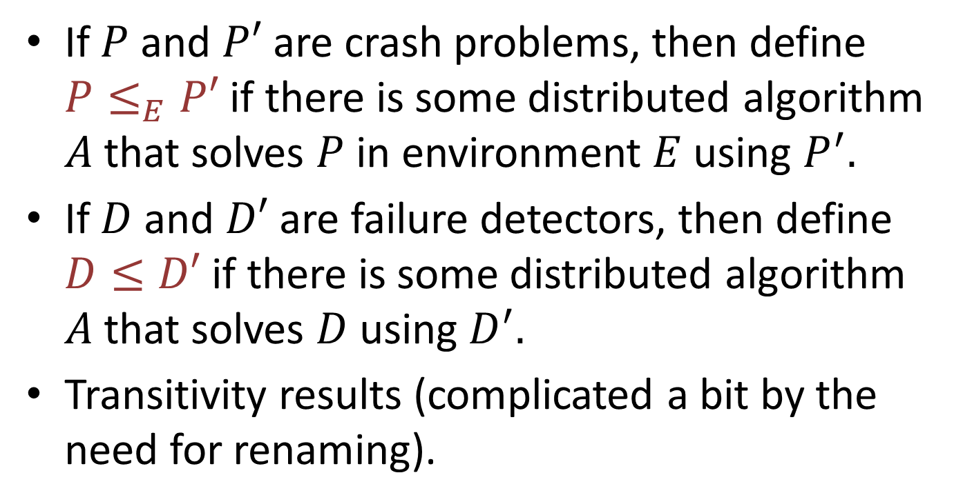
Comparing FDs, and other crash problems
If $P$ and $P′$ are crash problems, then define $P≤_{E}P′$ if there is some distributed algorithm $A$that solves $P$ in environment $E$ using $P^{′}.$
If $D$ and $D′$ are failure detectors, then define $D≤D′$ if there is some distributed algorithm $A$that solves $D$ using $D^{′}.$
Transitivity results (complicated a bit by the need for renaming).
Notes:
When we are implementing a FD (on the LHS of the inequality), we don’t need to include mention of any environment, since FD’s have no inputs from the environment.

Slide 36
4. Self-Implementability
Environment
Crash
1
2
n
D
Channels

Slide 37
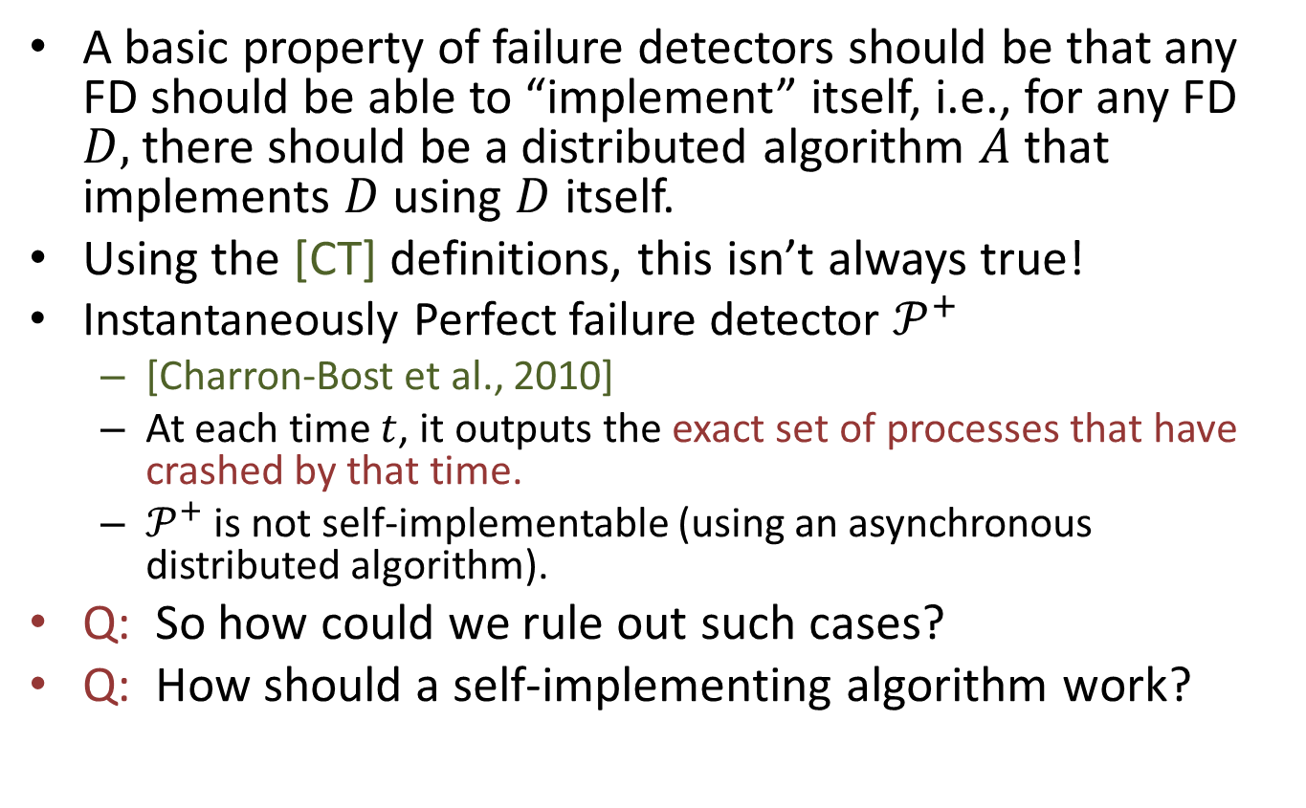
Self-Implementability
A basic property of failure detectors should be that any FD should be able to “implement” itself, i.e., for any FD $D,$there should be a distributed algorithm $A$that implements $D$ using $D$ itself.
Using the [CT] definitions, this isn’t always true!
Instantaneously Perfect failure detector $𝒫^{+}$
[Charron-Bost et al., 2010]
At each time $t$, it outputs the exact set of processes that have crashed by that time.
$𝒫^{+}$ is not self-implementable (using an asynchronous distributed algorithm).
Q: So how could we rule out such cases?
Q: How should a self-implementing algorithm work?
Notes:
Why would we expect this? In any setting, when we are classifying power of problems, we normally expect reflexivity. Look at various scenarios from complexity theory, recursion theory.
A process in an asynchronous distributed algorithm cannot know immediately when a crash has occurred elsewhere.

Slide 38
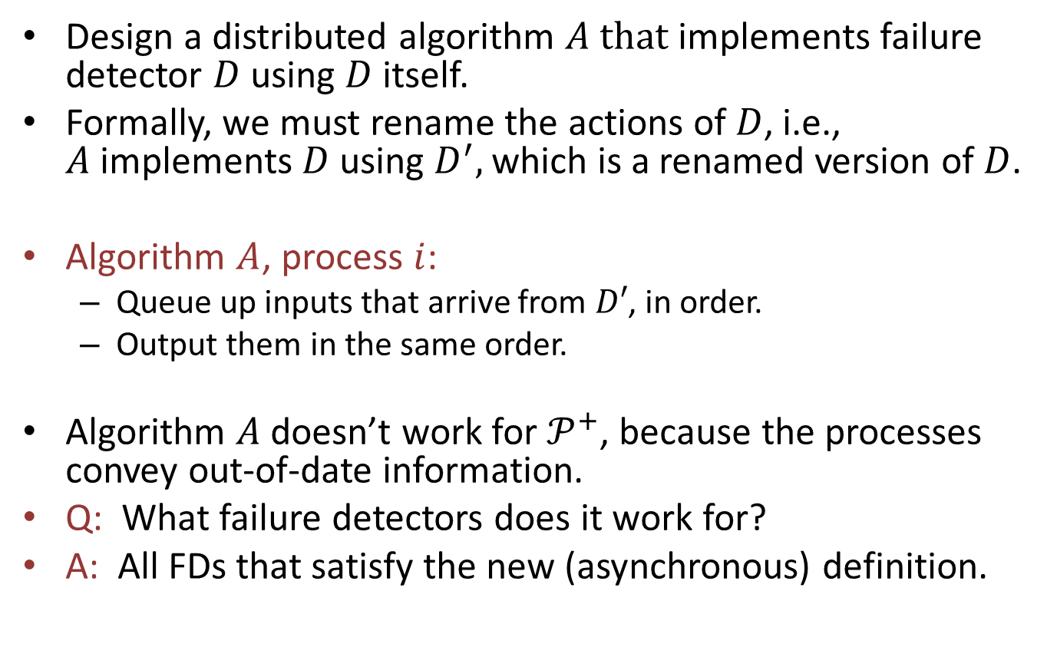
A Simple Algorithm
Design a distributed algorithm $A that$ implements failure detector $D$ using $D$ itself.
Formally, we must rename the actions of $D$, i.e., $A$implements $D$ using $D^{′},$which is a renamed version of $D$.
Algorithm $A$, process $i$:
Queue up inputs that arrive from $D′$, in order.
Output them in the same order.
Algorithm $A$doesn’t work for $𝒫^{+}$, because the processes convey out-of-date information.
Q: What failure detectors does it work for?
A: All FDs that satisfy the new (asynchronous) definition.
Notes:
We must rename the actions to be able to talk about “the same” actions at two different boundaries.

Slide 39
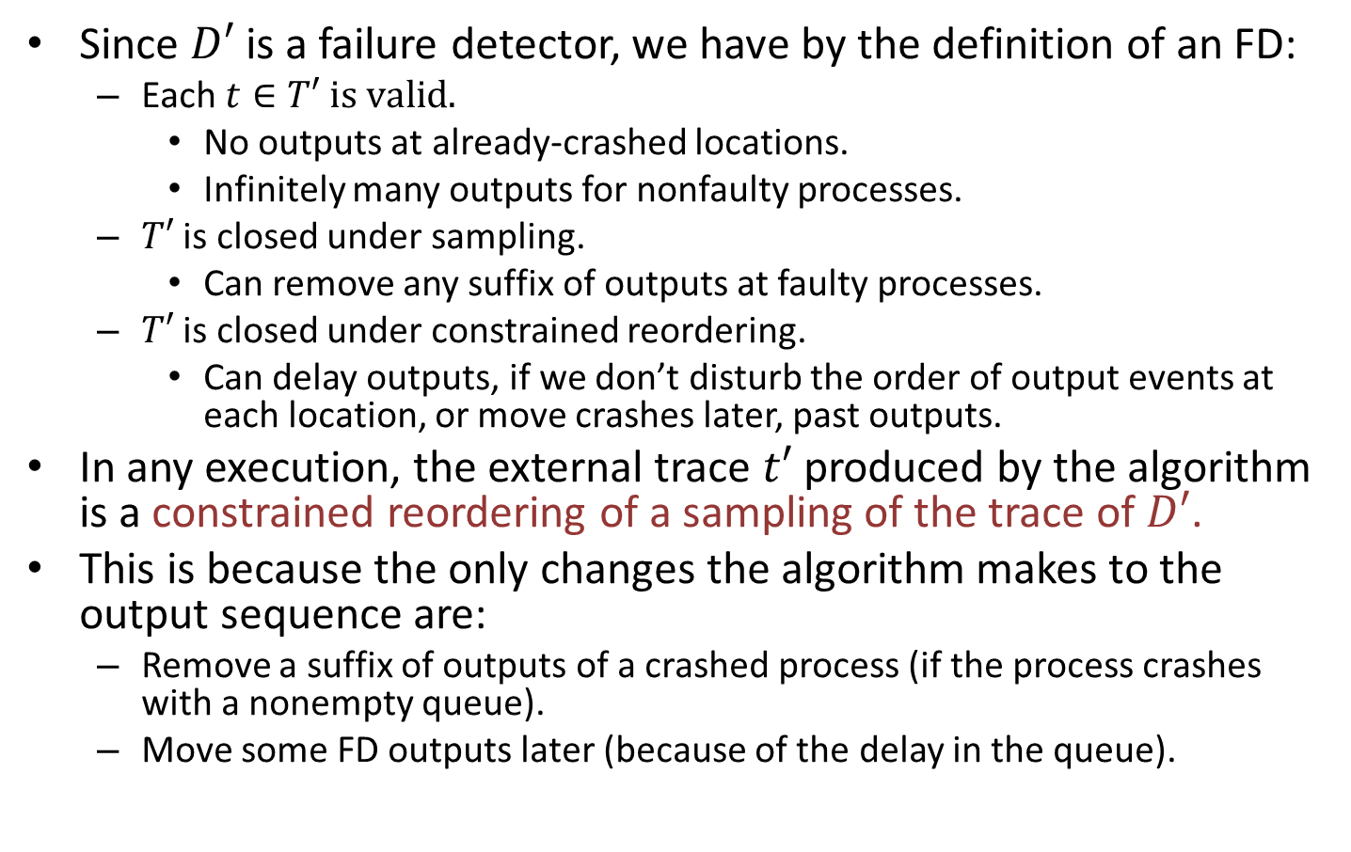
Why the Algorithm Works
Since $D′$is a failure detector, we have by the definition of an FD:
Each $t∈T′ is valid.$
No outputs at already-crashed locations.
Infinitely many outputs for nonfaulty processes.
$T′$ is closed under sampling.
Can remove any suffix of outputs at faulty processes.
$T′$ is closed under constrained reordering.
Can delay outputs, if we don’t disturb the order of output events at each location, or move crashes later, past outputs.
In any execution, the external trace $t′$ produced by the algorithm is a constrained reordering of a sampling of the trace of $D′$.
This is because the only changes the algorithm makes to the output sequence are:
Remove a suffix of outputs of a crashed process (if the process crashes with a nonempty queue).
Move some FD outputs later (because of the delay in the queue).
Notes:
This guarantees that the output trace satisfies the stronger requirements of the older definition of constrained reordering. That is certainly sufficient.
The assumptions we made are just what we needed to get self-implementability.

Slide 40
Remarks
We obtained self-implementability by adding some constraints to the FDs.
Constraints are minimal, satisfied by nearly all the interesting FDs in the literature.
But not satisfied by some “oddities”.

Slide 41
5. Examples: Comparing Typical FDs
Environment
Crash
1
2
n
D’
Channels

Slide 42
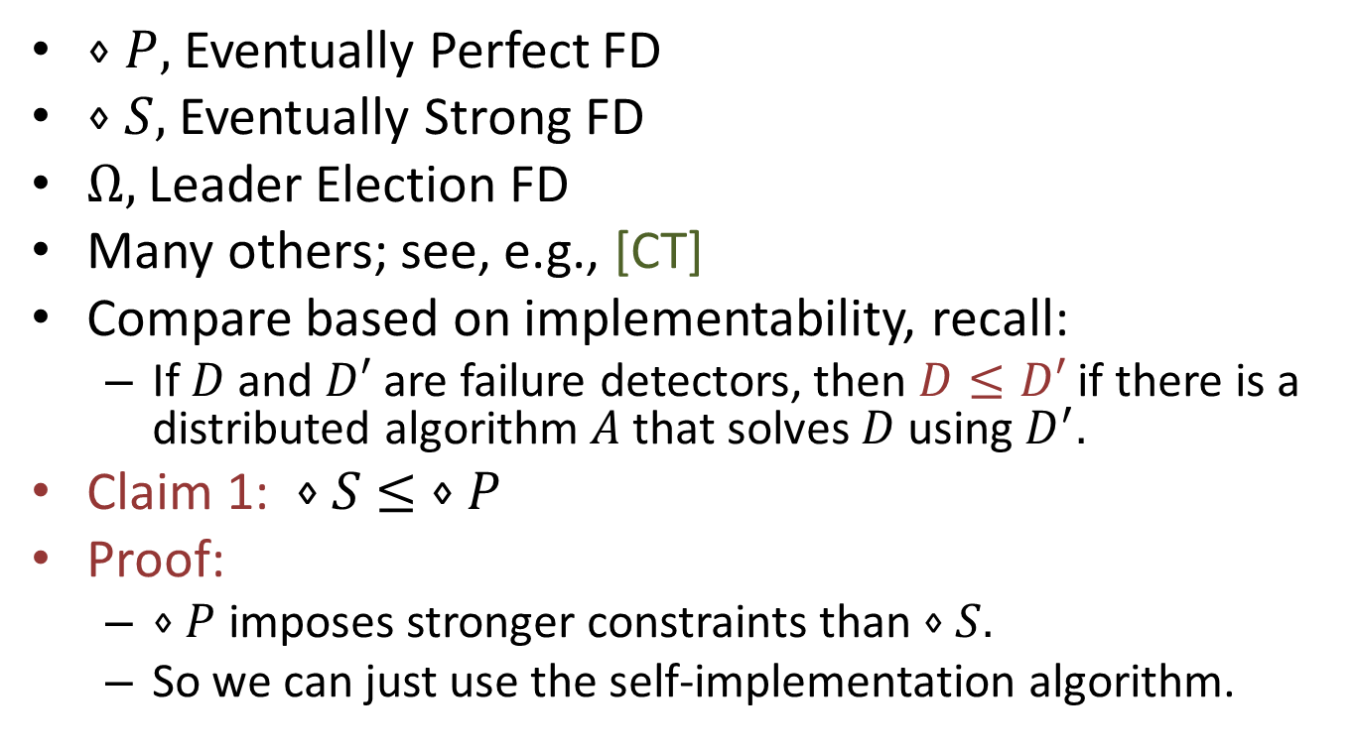
Typical FDs
$⋄P,$Eventually Perfect FD
$⋄S,$Eventually Strong FD
$Ω,$Leader Election FD
Many others; see, e.g., [CT]
Compare based on implementability, recall:
If $D$ and $D′$ are failure detectors, then $D≤D′$ if there is a distributed algorithm $A$that solves $D$ using $D^{′}.$
Claim 1: $⋄S$ $≤ ⋄P$
Proof:
$⋄P$ imposes stronger constraints than $⋄S.$
So we can just use the self-implementation algorithm.
Notes:
Diamond-S and Diamond-P have the same completeness requirements.
For accuracy, Diamond-S requires only that in some suffix, SOME correct process isn’t suspected by anyone.
On the other hand, Diamond-P requires that in some suffix, ALL correct processes aren’t suspected by anyone.
It doesn’t matter exactly what they are---the key fact is that Diamond-P “implies” Diamond-S.
Since technically we need a distributed algorithm A to satisfy the formal definition, use the queue-based self-implementation algorithm. That yields Diamond-P, which a fortioti yields Diamond-S.

Slide 43

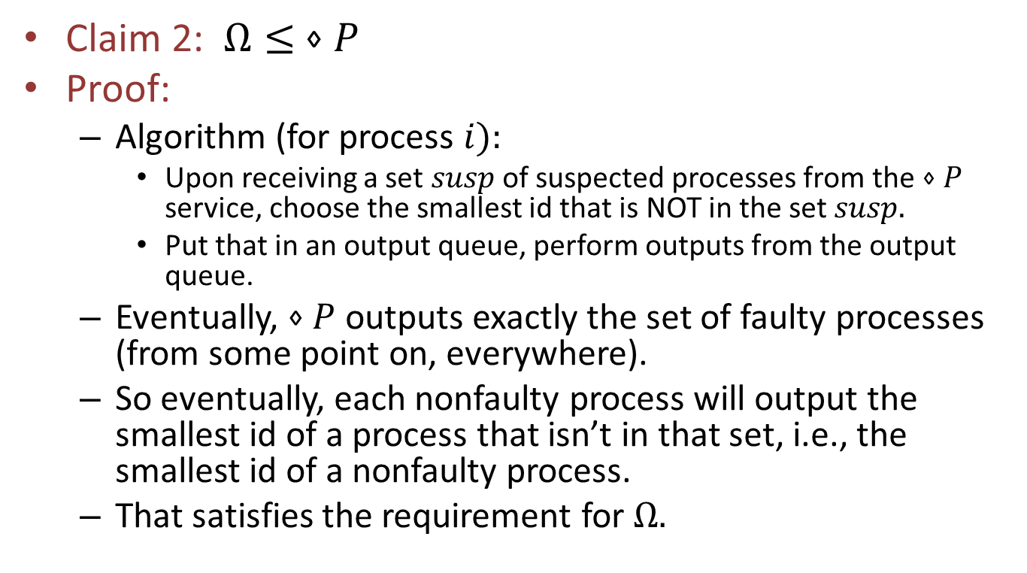
$$Ω≤ ⋄P$$
Claim 2: $Ω≤ ⋄P$
Proof:
Algorithm (for process $i):$
Upon receiving a set $susp$of suspected processes from the $⋄P$ service, choose the smallest id that is NOT in the set $susp.$
Put that in an output queue, perform outputs from the output queue.
Eventually, $⋄P$outputs exactly the set of faulty processes (from some point on, everywhere).
So eventually, each nonfaulty process will output the smallest id of a process that isn’t in that set, i.e., the smallest id of a nonfaulty process.
That satisfies the requirement for $Ω.$

Slide 44
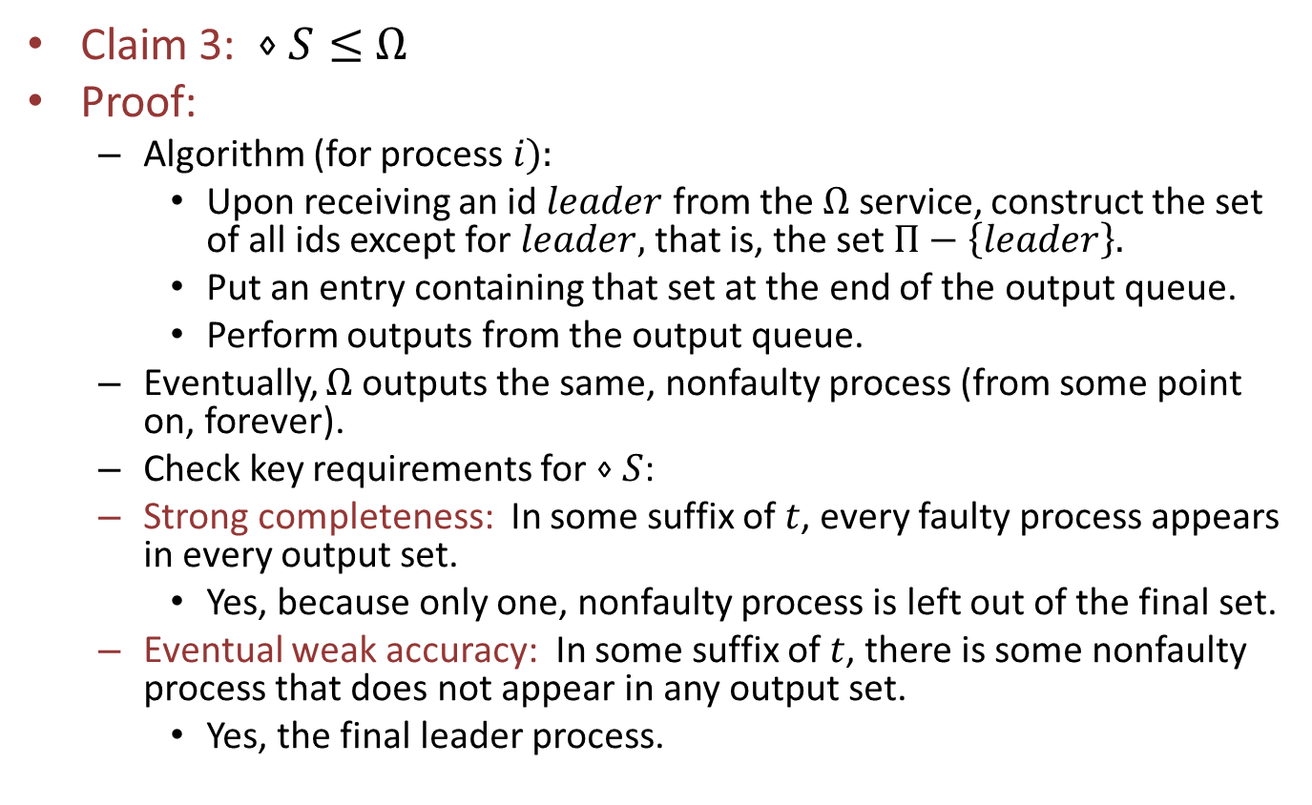

$⋄S≤$ $Ω$
Claim 3: $⋄S≤$ $Ω$
Proof:
Algorithm (for process $i):$
Upon receiving an id $leader$ from the $Ω$ service, construct the set of all ids except for $leader,$ that is, the set $Π−\left\{leader\right\}.$
Put an entry containing that set at the end of the output queue.
Perform outputs from the output queue.
Eventually, $Ω$outputs the same, nonfaulty process (from some point on, forever).
Check key requirements for $⋄S$:
Strong completeness: In some suffix of $t$, every faulty process appears in every output set.
Yes, because only one, nonfaulty process is left out of the final set.
Eventual weak accuracy: In some suffix of $t$, there is some nonfaulty process that does not appear in any output set.
Yes, the final leader process.

Slide 45
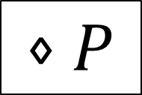
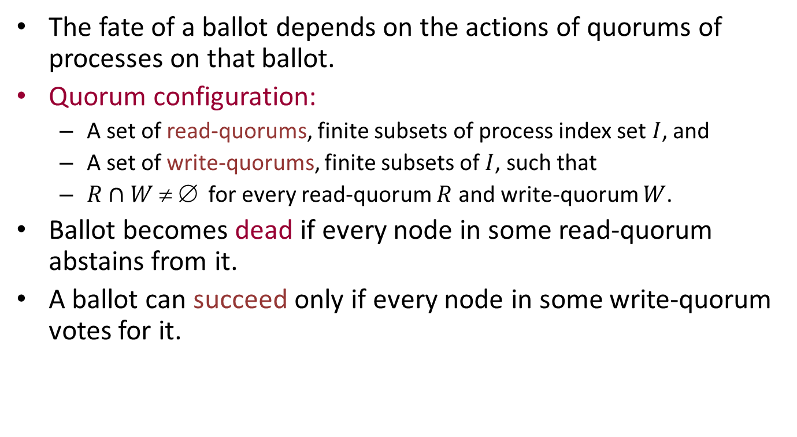
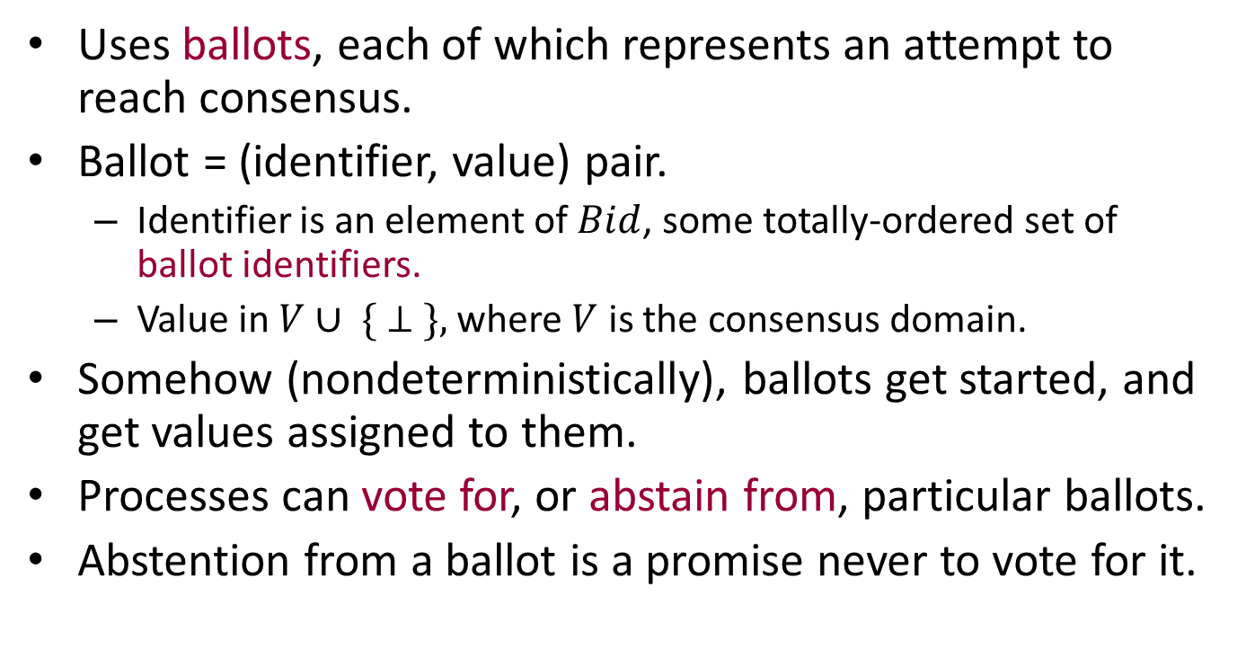
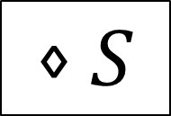
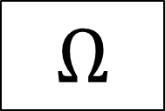
Summary
$$⋄P$$
$$≥$$
$$Ω$$
$$≥$$
$$⋄S$$
Q: What about the other relationships?
Notes:
E.g., is Diamond-P strictly stronger than Omega, or can Omega somehow be used to implement Diamond-P?

Slide 46
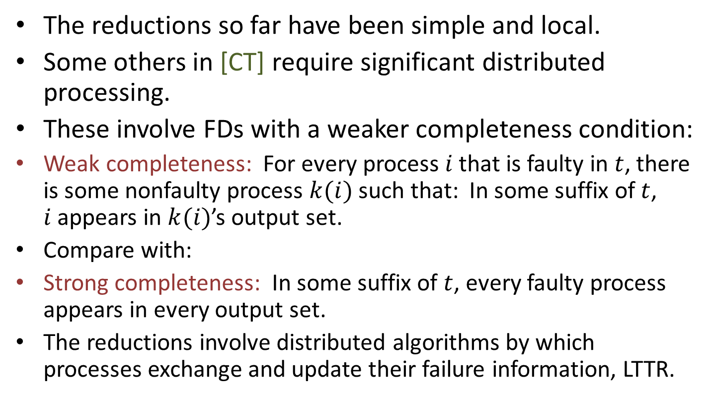
Other reductions
The reductions so far have been simple and local.
Some others in [CT] require significant distributed processing.
These involve FDs with a weaker completeness condition:
Weak completeness: For every process $i$ that is faulty in $t$, there is some nonfaulty process $k(i)$ such that: In some suffix of $t$, $i$appears in $k(i)$’s output set.
Compare with:
Strong completeness: In some suffix of $t$, every faulty process appears in every output set.
The reductions involve distributed algorithms by which processes exchange and update their failure information, LTTR.
Notes:
See p. 12 of the CT paper.
“Each faulty process is suspected by someone.”
Processes simply exchange their failure sets periodically.
When process i receives a failure set from process j, it removes process j from its own failure set and adds in all the ids that process j sent.

Slide 47
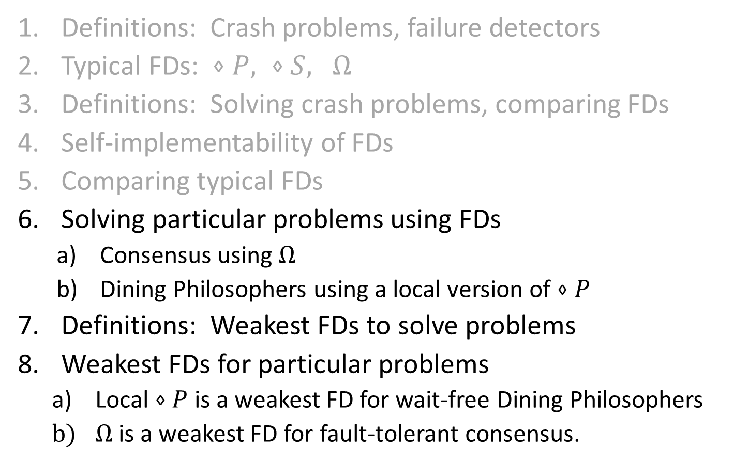
Overview
Definitions: Crash problems, failure detectors
Typical FDs: $⋄P, ⋄S,$ $Ω$
Definitions: Solving crash problems, comparing FDs
Self-implementability of FDs
Comparing typical FDs
Solving particular problems using FDs
Consensus using $Ω$
Dining Philosophers using a local version of $⋄P$
Definitions: Weakest FDs to solve problems
Weakest FDs for particular problems
Local $⋄P$ is a weakest FD for wait-free Dining Philosophers
$Ω$is a weakest FD for fault-tolerant consensus.
Notes:
Last year, this was two lectures. So this year I’ll speak at a higher level, leave out many details.

Slide 48
6. Solving Problems Using FDs: Consensus and Dining Phillosophers
Environment
Crash
1
2
n
D
Channels

Slide 49
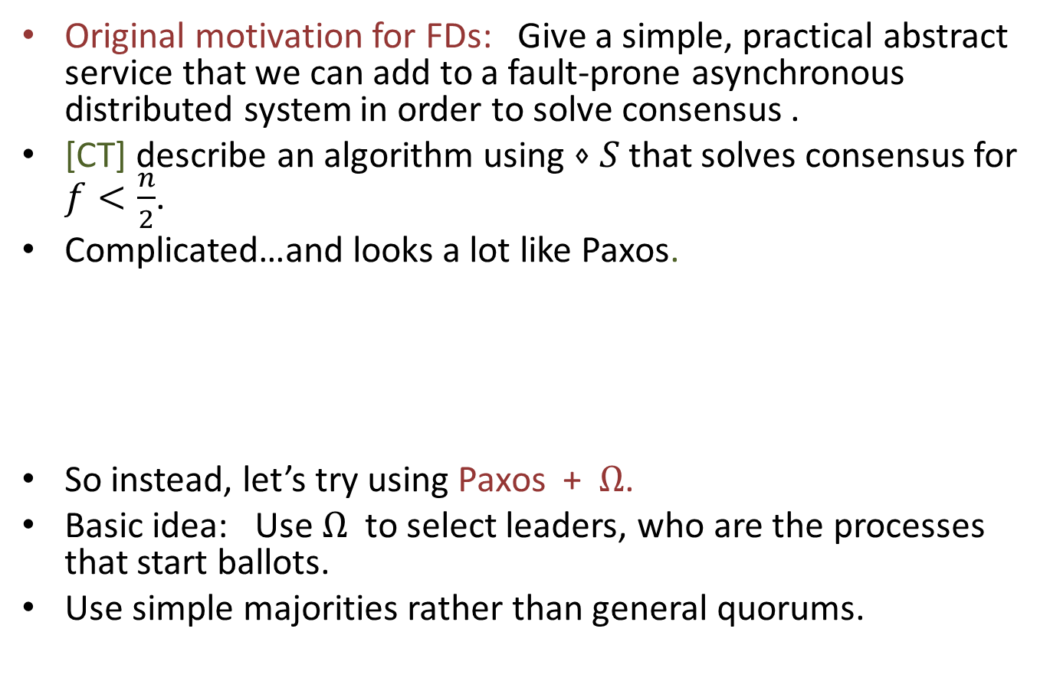
Fault-Tolerant Consensus Using FDs
Original motivation for FDs: Give a simple, practical abstract service that we can add to a fault-prone asynchronous distributed system in order to solve consensus .
[CT] describe an algorithm using $⋄S$ that solves consensus for $f<\frac{n}{2}$.
Complicated…and looks a lot like Paxos.
So instead, let’s try using Paxos + $Ω$.
Basic idea: Use $Ω$ to select leaders, who are the processes that start ballots.
Use simple majorities rather than general quorums.
Notes:
What does it mean, in our new framework, to solve consensus for a certain number of failures? The Crash automaton can produce any number of failures, so where in the model do we put the restrictions?
The answer is that we rewrite our specs to require good behavior only in cases where the failures are limited. We allow all traces in which the failures aren’t limited. So the failure limitation is just built into each spec. Formally, we define a service Omega_f, which is guaranteed to behave like Omega in executions in which at most f failures occur.
Technically, we should also say what environments we are allowing.
For fault-tolerant consensus, it is any environment that submits at most one input at each location, and in fair executions, submits exactly one.
Interface consists of propose (init) outputs from E to the system, and decide inputs to E from the system.

Slide 50
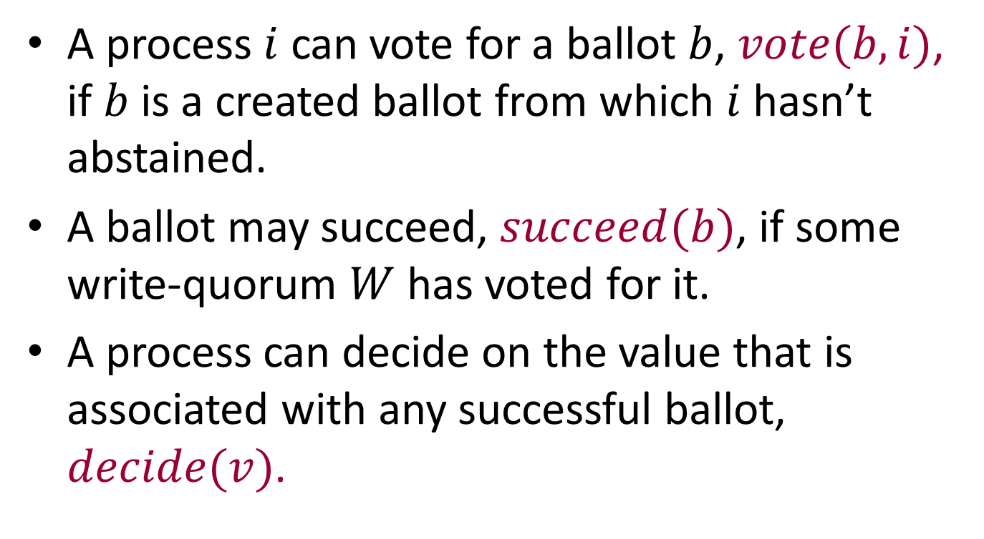
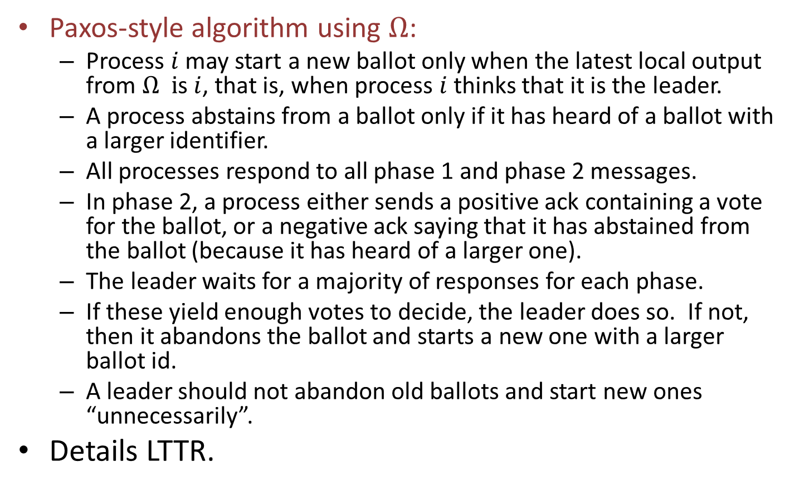
Consensus Algorithm Using $Ω$
Paxos-style algorithm using $Ω$:
Process $i$ may start a new ballot only when the latest local output from $Ω i$s $i$, that is, when process $i$ thinks that it is the leader.
A process abstains from a ballot only if it has heard of a ballot with a larger identifier.
All processes respond to all phase 1 and phase 2 messages.
In phase 2, a process either sends a positive ack containing a vote for the ballot, or a negative ack saying that it has abstained from the ballot (because it has heard of a larger one).
The leader waits for a majority of responses for each phase.
If these yield enough votes to decide, the leader does so. If not, then it abandons the ballot and starts a new one with a larger ballot id.
A leader should not abandon old ballots and start new ones “unnecessarily”.
Details LTTR.
Notes:
We must first argue that this doesn’t “get stuck” anywhere.
Then, eventually we get a permanent leader, and we must argue that it eventually reaches a decision.
If the leader abandons a ballot, it must be because it learns that a larger one exists. Then it tries again.
Eventually, it must pick a ballot id that is larger than any other id for a ballot that it, or anyone else, has ever started.
Then nothing causes the ballot to fail. No one will abstain from it because of a larger ballot, and everything completes successfully.

Slide 51
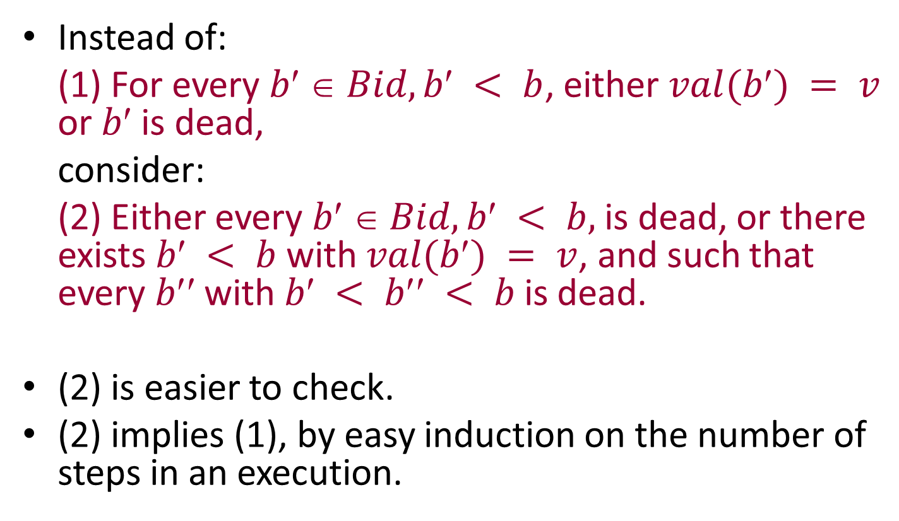
Fault-Tolerant Consensus Using FDs
So, we can solve fault-tolerant consensus for $f<\frac{n}{2},$ provided we have an eventually-stable, nonfaulty leader.
[CT] also prove a lower bound saying that, even with $⋄P,$ it’s impossible to solve consensus with $f≥\frac{n}{2}…$
Notes:
The fault-tolerance specification is part of the basic problem definition---no requirements if f is larger.
Perhaps the fact that we can solve this with a stable leader is not so surprising.
Lower bound is like others we have seen…

Slide 52
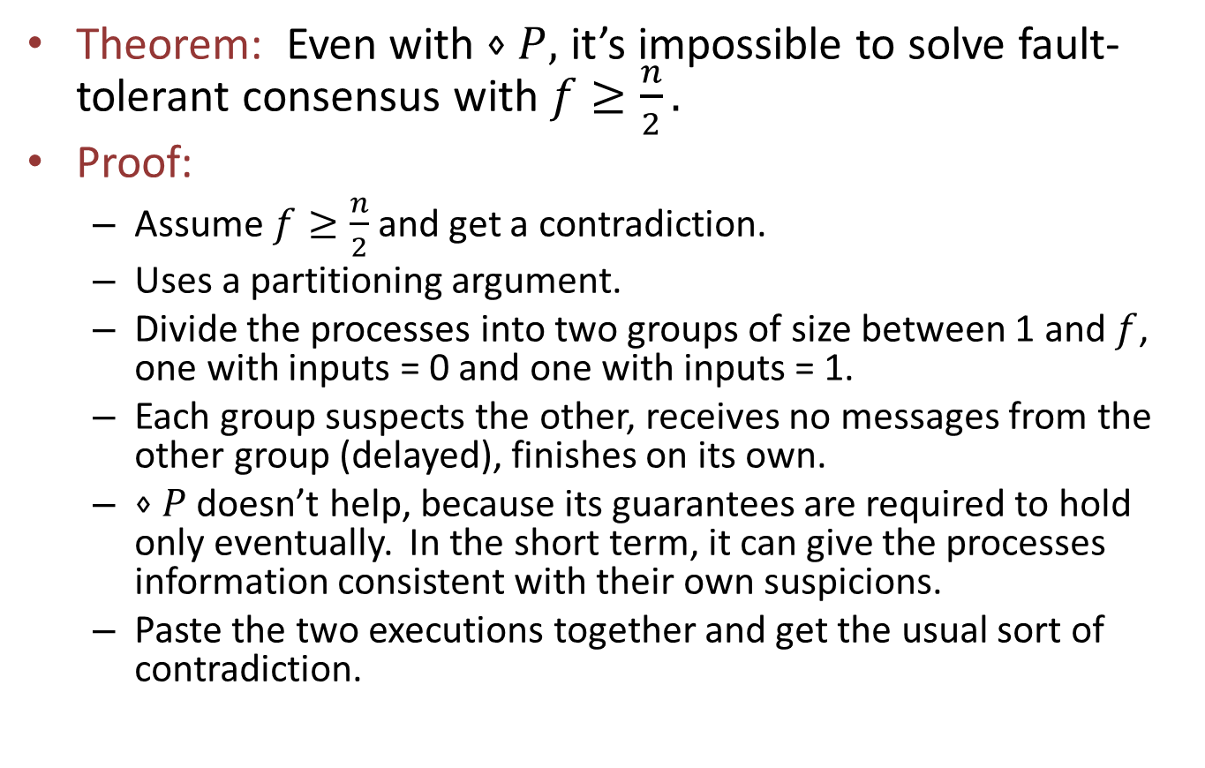
Lower Bound for Consensus Using FDs
Theorem: Even with $⋄P,$ it’s impossible to solve fault-tolerant consensus with $f≥\frac{n}{2}.$
Proof:
Assume $f≥\frac{n}{2}$and get a contradiction.
Uses a partitioning argument.
Divide the processes into two groups of size between 1 and $f$, one with inputs = 0 and one with inputs = 1.
Each group suspects the other, receives no messages from the other group (delayed), finishes on its own.
$⋄P$ doesn’t help, because its guarantees are required to hold only eventually. In the short term, it can give the processes information consistent with their own suspicions.
Paste the two executions together and get the usual sort of contradiction.
Notes:
The theorem is informally stated here.
We could give a definition of f-fault-tolerant consensus for any f, by building the fault-tolerance condition into the basic spec (no requirements if failures exceed f).
Then for cases where f is large, the problem is not solvable with Diamond-P.
We should also specify a class of environments---the usual ones for consensus. We can use a canonical environment that is allowed to submit any input, 0 or 1, at each location. This environment is described in Section 9.2 of the Cornejo, Lynch, Sastry TR.
Here, “suspects” means simply that the group considers itself to be in an execution where the other group has failed.
Messages between the groups may be delayed.

Slide 53
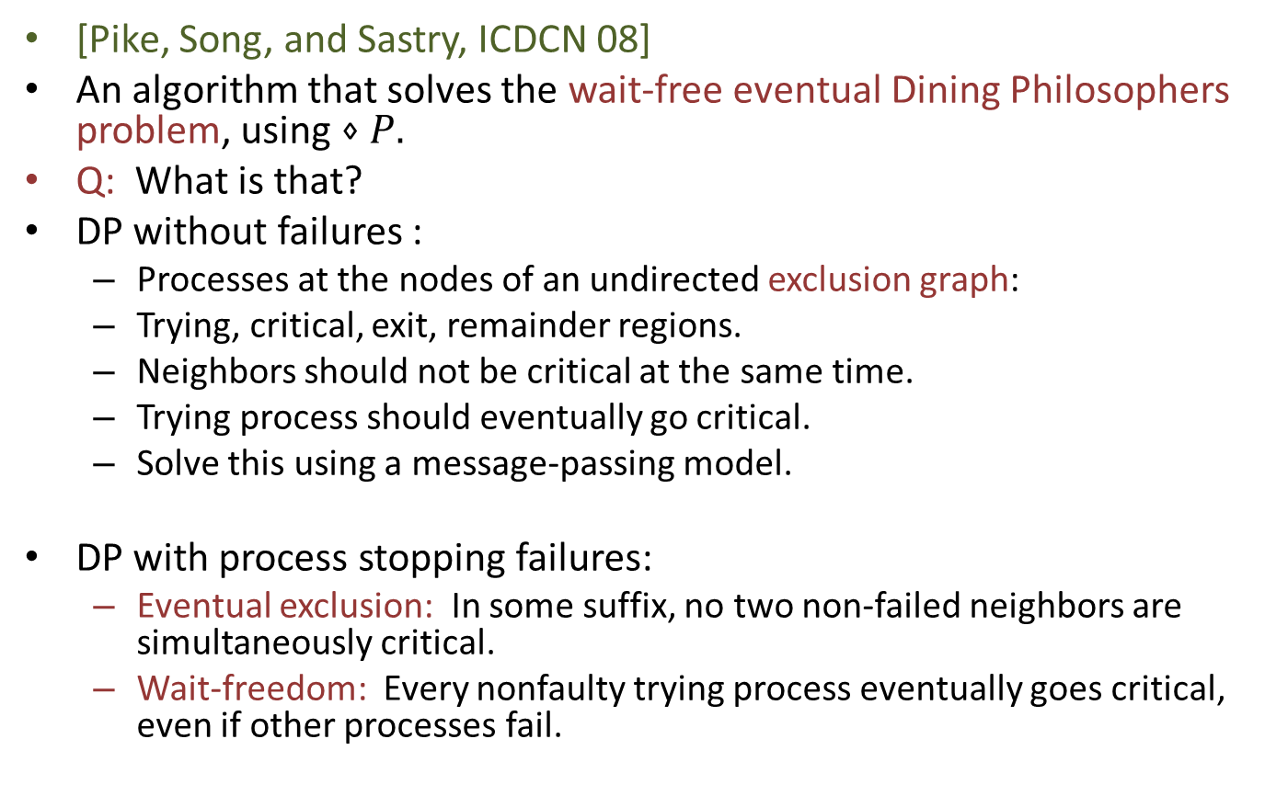
Wait-Free Dining Philosophers Using FDs
[Pike, Song, and Sastry, ICDCN 08]
An algorithm that solves the wait-free eventual Dining Philosophers problem, using $⋄P.$
Q: What is that?
DP without failures :
Processes at the nodes of an undirected exclusion graph:
Trying, critical, exit, remainder regions.
Neighbors should not be critical at the same time.
Trying process should eventually go critical.
Solve this using a message-passing model.
DP with process stopping failures:
Eventual exclusion: In some suffix, no two non-failed neighbors are simultaneously critical.
Wait-freedom: Every nonfaulty trying process eventually goes critical, even if other processes fail.
Notes:
To show that these ideas apply to something other than consensus…
This formulation is a variant of what we used before. It’s like our exclusion specification, but based just on pairs of processes (neighbors in the graph).
Messages are sent on channels that correspond to the edges.

Slide 54
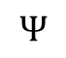
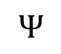
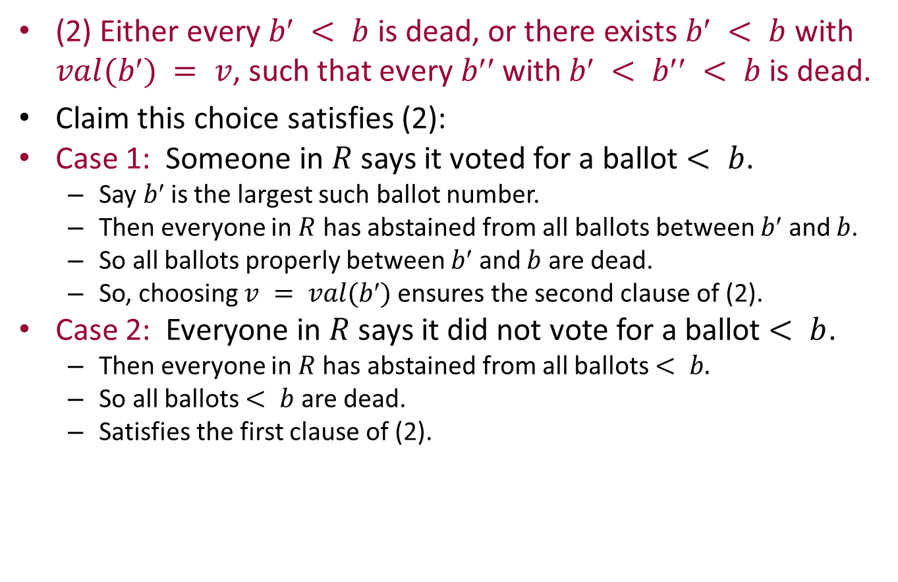
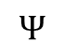
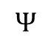








DP Algorithm Using $⋄P$
Two primary mechanisms, forks and priorities.
Forks:
Associate a fork with each edge in the graph.
Represented explicitly, by a token that may reside at the process at either end of the edge, or be “in transit” in one of the channels between them.
Priorities:
Each process maintains its own priority value, made unique by using process ids as tiebreakers.
$$Ψ$$
$$Ψ$$
$$Ψ$$
$$Ψ$$
$$Ψ$$
$$Ψ$$
$$Ψ$$
$$Ψ$$
$$Ψ$$
$$Ψ$$
$$Ψ$$
$$Ψ$$
$$Ψ$$
Notes:
We should also specify the environments we are considering. They are the usual environments for Dining Philosphers. They observe the handshake discipline: try, crit, exit, rem. And in fair executions, they eventually exit whenever they are in the critical region.

Slide 55




Basic fork collection scheme, no failures
Trying process $i$tries to collect the forks for all incident edges.
Requests all missing forks.
Neighbors might or might not send the requested forks:
Processes in the remainder region, and lower-priority trying processes, always honor fork requests.
Processes in the critical (or exit) region, and higher-priority trying processes, always defer fork requests (waiting for conditions to change).
When process $i$ has all forks, it enters the critical region.
request
$$Ψ$$
$$Ψ$$
$$Ψ$$
Notes:
This basic algorithm, without failure, appears in the Chandy-Misra paper on Drinking Philosophers (as a preliminary Dining Phil. Algorithm).

Slide 56

Basic fork collection scheme, no failures
Trying process $i$tries to collect the forks for all incident edges.
Requests all missing forks.
Neighbors might or might not send the requested forks:
Processes in the remainder region, and lower-priority trying processes, honor fork requests.
Processes in the critical (or exit) region, and higher-priority trying processes, defer fork requests.
When process $i$ has all forks, it enters the critical region.
Upon exiting the critical region, process $i$ reduces its priority below those of all its neighbors and honors all deferred fork requests.
To keep track of priorities, each process sends its latest priority on every message.
This clearly guarantees exclusion.
In the absence of failures, it also guarantees lockout-freedom.
Notes:
Priorities must be unique---use a tie-breaker to ensure this.
Lockout-freedom.
Arguments in Jennifer Welch’s link reversal book should work to show this.
Or, we could develop an argument as on a later slide, based on the highest priority requester always succeeding and then lowering the priority---that way everyone eventually becomes the highest priority requester.
This depends on no infinite decreasing chains.
This basic algorithm, without failure, appears in the Chandy-Misra paper on Drinking Philosophers (as a preliminary Dining Phil. Algorithm).
Guarantees DP and lockout-freedom (with no failures).

Slide 57

What about failures?
Now consider process stopping failures.
We want wait-freedom: Every nonfaulty trying process eventually goes critical, even if other processes fail.
In the current scheme, if a neighbor has crashed, it never sends the fork, which means that its neighbors may be stalled, and so their neighbors may be stalled,…
So, modify the rule for entering the critical region, using $⋄P:$
Trying process $i$ may enter the critical region if for every incident edge $(i,j)$, either process $i$ has the fork, or process $i$ believes that process $j$ has failed, because $j$is included in the most recent output set of $⋄P$ at location $i$.
And modify the rule for exiting the critical region:
Reduce the priority, but now we can’t be sure this will be less than that of all neighbors.
Honor all deferred fork requests anyway.
Notes:
We can stall the entire system, based on waiting chains.
Now we introduce the failure detector.
We can’t be sure this will be less, because we can’t communicate reliably since some neighbors might have failed (or might not, we can’t be sure at any finite point).

Slide 58
Guarantees
Eventual exclusion: In some suffix, no two non-failed neighbors are simultaneously critical.
Wait-freedom: Every nonfaulty trying process eventually goes critical, even if other processes fail.

Slide 59

Wait-Freedom
Wait-freedom: Every nonfaulty trying process eventually goes critical, even if other processes fail.
Proof sketch:
Eventually, all crashes have happened.
By strong completeness, from some point on,$⋄P$ always reports the failure of all faulty processes.
So a trying process $i$ will not be blocked forever by a failed neighbor.
Process $i$ must still obtain all forks from nonfaulty neighbors.
This depends on careful management of the priorities.
Inconsistent views of priorities could result in deadlock: If each of two neighbors thinks it has higher priority than the other, then neither might send a requested fork.
Notes:
E.g., if we have two neighbors, each of which thinks it has higher priority than a neighbor, then neither might send a requested fork. ??

Slide 60
Wait-Freedom
Wait-freedom: Every nonfaulty trying process eventually goes critical, even if other processes fail.
Proof sketch, cont’d:
One priority scheme that works:
Priorities are of the form (Integer, process ID)
Reduce priority by some arbitrary amount (not necessarily lower than neighbors) when leaving the critical region.
Change priority only when leaving the critical region.
Highest priority nonfaulty trying process in the entire network gets all its needed forks, enters the critical region, and lowers its priority.
So eventually, every nonfaulty trying processes becomes the highest priority nonfaulty trying process and enters the critical region.
Notes:
Processes need not become the highest priority right away---it could take longer than if they had reliable priority information.

Slide 61

Eventual Exclusion
Eventual exclusion: In some suffix, no two non-failed neighbors are simultaneously critical.
Proof:
Eventually, all crashes have happened.
By eventual strong accuracy$,$eventually$⋄P$ stops reporting that correct processes have crashed, i.e., it reports only actual crashes.
Let $π$be a point in the execution after all this has happened.
Consider what happens after point $π$, and after the effects of old errors disappear.
Consider any two neighbors $i$ and $j$ that both start trying after point $π$.
In order to enter the critical region, each must actually obtain the fork corresponding to the edge between them, and will keep it during its time in the critical region.
So they can’t end up in the critical region at the same time.
Notes:
Old errors can involve, for example, processes that are already in the critical region.
Or processes that requested before the stabilization point and must go to the critical region (which they will, because of wait-freedom).
There might be other cases.
Perhaps show some example of how we can get such residual effects? Or maybe that is not interesting.
Actually, I am not sure how we can get multiple new entries from one process after point pi, as Srikanth indicates on the next slide. ??
Each must obtain the fork, since the second possibility involves incorrect failure detection and can no longer hold.
This argument is reminiscent of the mutex argument for Dijkstra.

Slide 62

Remarks
Power of FDs:
These results show that FDs can help in solving other problems besides fault-tolerant consensus.
Local $⋄P:$
Here, $⋄P$ could be weakened to a “local” version, where the FD at each location reports only about the failure status of neighboring locations.
Behaving correctly for “sufficiently long”:
Eventual FDs like $⋄P$ seem strong, because they must behave correctly from some point on, forever.
In most cases, behaving correctly for “sufficiently long” is good enough.
Notes:
Technically, we should show that WF DP can’t be solved in the absence of FDs. An indistinguishability argument should work.
No reason processes need to hear about crashes of non-neighbors---they don’t use this.

Slide 63

Overview
Definitions: Crash problems, failure detectors
Typical FDs: $⋄P, ⋄S,$ $Ω$
Definitions: Solving crash problems, comparing FDs
Self-implementability of FDs
Comparing typical FDs
Solving particular problems using FDs
Consensus using $Ω$
Dining Philosophers using a local version of $⋄P$
Definitions: Weakest FDs to solve problems
Weakest FDs for particular problems
Local $⋄P$ is a weakest FD for wait-free Dining Philosophers
$Ω$is a weakest FD for fault-tolerant consensus.
Notes:
Last year, this was two lectures. So this year I’ll speak at a higher level, leave out many details.

Slide 64
7. Weakest Failure Detector definitions
Environment
Crash
1
2
n
D
Channels

Slide 65

Weakest Failure Detectors
Failure detector $D$ is a weakest FD (WFD) for problem $P$ in environment $E$ iff:
$P≤_{E}D$, that is:
$D$ is sufficient to solve $P$ in environment $E$, i.e.,
There is a distributed algorithm $A$ that solves $P$ in environment $E$ using $D$.
For any failure detector $D′$that is sufficient to solve $P$in environment $E$, $D≤ D′$, that is:
$D′$ is sufficient to implement $D,\text{i}\text{.}\text{e}\text{.}\text{,}$
There is a distributed algorithm $A$ that implements $D$using $D′$.
Failure detector $D$ is a weakest FD for problem $P$ in a class of environments if it is a weakest FD for $P$ in every environment in the class.
Notes:
The second direction says that D’ is stronger than D, in a sense.
Go over this at length.

Slide 66
8. Weakest Failure Detectors for Dining Philosophers and Consensus
Environment
Crash
1
2
n
D
Channels

Slide 67

A Weakest FD for Dining Philosophers
[Sastry, Pike, Welch, SPAA 09]
We showed that $⋄P$ solves wait-free Dining Philosophers.
A local version of $⋄P$ suffices, where each location reports only about the failure status of its neighboring locations.
This local version of $⋄P$ is a weakest failure detector for wait-free Dining Philosophers.
Notes:
Technically, we have shown that Diamond-P solves w-f DP in all environments of the usual kind for DP.

Slide 68


Definition of Local $⋄P$
Outputs at each location are a subset of the set of neighboring locations.
Each trace $t∈T$ satisfies:
Validity
Strong completeness: In some suffix of $t$, every faulty neighbor appears in every output set.
Eventual strong accuracy: In some suffix of $t$, no nonfaulty neighbor appears in any output set.
Notes:
Validity: $t$contains infinitely many outputs at each nonfaulty location, and contains no outputs after a crash at any faulty location
Easy to show that local $⋄P$ satisfies our definition of an (asynchronous) FD.

Slide 69

Weakest FD for Dining Philosophers
Theorem: Local $⋄P$ is a weakest FD for wait-free Dining Philosophers.
More strongly, it is a representative FD: there is a distributed algorithm that implements Local $⋄P$using finitely many instances of DP$.$
Proof:
An interesting technical construction.
See Fall, 2014 course slides, or the [SPW] paper.
Notes:
Argue that this really is stronger, that is, a representative FD is also a weakest FD:
If some FD D solves DP, then D can be used to implement Local-diamond-P.
Just plug in the implementation of DP using D, for all the (finitely many) instances of DP in the assumed implementation of Local-diamond-P.
We can use just one instance of D in doing this.

Slide 70

A Weakest FD for Consensus
[Chandra, Hadzilacos, Toueg], [Lynch, Sastry]
Theorem: Assume $f < n/2$. Then $Ω_{f}$is a weakest FD for $f$-fault-tolerant consensus.
Here, $Ω_{f}$is assumed to behave like $Ω$, in executions with at most $f$ failures.
Notes:
Much was missing from the published [CHT] proof.
So we have written a new version, based on our asynchronous FDs.
Here, Omega f is just like Omega, in environments with at most f failures.

Slide 71

Proof Strategy
Start with any distributed algorithm $A$ and failure detector $D$ such that $A$ uses $D$ to solve $f$-fault-tolerant consensus.
Use $A$ and $D$ to construct a new distributed algorithm $AΩ$ that implements $Ω_{f}$.
Part 1 of the proof: Analyze the structure of executions of $A$ and $D$ that allows them to solve consensus.
Define an execution tree of $A$ with $D$.
Show that the execution tree contains a decision gadget.
A decision gadget has a critical process, which must be nonfaulty.
Part 2: Devise a distributed algorithm that, using the actual FD $D,$emulates algorithm $A$ running with $D,$ and uses the emulation results to extract such a nonfaulty process. This yields the properties required for $Ω_{f}$.
Notes:
I’m writing Omega instead of Omega_f. Being a bit sloppy.
Now start ignoring the environments, in these class notes. The environment we want to consider for consensus basically expresses some well-formedness conditions (at most one input at each location).
The properties of Omega that need to be guaranteed: In some suffix, the FD outputs a particular, nonfaulty process at every location.

Slide 72

Part 1
Analyze the structure of executions of $A$ with $D$ that allows them to solve consensus.
Do this in several stages:
Define observation DAGs; each observation DAG $G$represents some possible outputs of $D$, plus some ordering relationships among these outputs.
If $G$is consistent with the outputs in some actual execution of $D$, then it’s viable.
Define the execution tree of $A$ for any particular observation DAG $G$.
Show that, if $G$is viable, the resulting execution tree contains a decision gadget for solving consensus.
Such a decision gadget has a critical process, which must be nonfaulty.
Notes:
Why are we talking about DAGs here?
In the simulation (in Part 2), the nodes will get only partial information about the FD outputs. They will not know the real total order of events, but will only get some partial ordering information. So they will have to work with such observations.

Slide 73

Observation DAGs
Consider a particular failure detector $D=\left(I,O,T\right).$
An observation DAG $G$for $D$ has vertices of the form $\left[i,k,e\right],$ where $i$is a location, $k$is a positive integer, and $e$is an output in $O.$
$\left[i,k,e\right]$ means that $D$’s $k$^{th} output at location $i$ is $e$.
For each $i$and $k,$ at most one triple.
For each $i$, the values of $k$ form a prefix of the positive integers.
Location $i$is live in $G$ if $G$ contains infinitely many vertices for $i$.
$G$ has edges representing some ordering relationships between the vertices.
Order the triples for the same $i$, according to values of $k$.
Transitively closed.
For every vertex $\left[i,k,e\right],$and every $j$that is live in $G,$there is an edge from $\left[i,k,e\right]$ to some vertex for $j.$
Notes:
Prefix doesn’t have to be finite prefix here. Could be all the integers.
Every live j eventually hears about every FD output represented at some node in the DAG.

Slide 74
An observation DAG
[3,1,e₅]
[1,1,e₁]
[2,1,e₃]
[1,2,e₂]
[3,2,e₆]
[2,2,e₄]
Notes:
This is a finite observation DAG.
It could be continued to an infinite one, by adding infinitely many nodes for one or more of the locations.

Slide 75

Viable observations DAGs
So far, the outputs $e$in the observation DAG could be any values from $O,$not related to the actual behavior of$D=\left(I,O,T\right).$
Define $G$ to be viable for $D$ provided that there is a topological ordering of the vertices of $G$ whose event sequence is exactly the output subsequence of some $t∈T.$

Slide 76
A viable observation DAG
[3,1,e₅]
[1,1,e₁]
[2,1,e₃]
[1,2,e₂]
[3,2,e₆]
[2,2,e₄]
The total ordering might be [1,1,e1], [3,1,e5], [1,2, e2],[2,1,e3],[2,2,e4],[3,2,e6].
The full (valid) trace in T might be e1, e5, e2, crash1, e3, e4, crash2, e6, crash3.
Notes:
This is a finite observation DAG.
So none of the locations is live.
Still, some total ordering of the event sequence must be allowed by the FD D.
E.g., [1,1,e1], [3,1,e5], [1,2, e2],[2,1,e3],[2,2,e4],[3,2,e6] could be the ordering, in which case the FD can produce the sequence e1, e5, e2, e3, e4, e6, with some crashes interspersed.
Perhaps the full trace might be e1, e5, e2, crash1, e3, e4, crash2, e6, crash3.
Note that, since every location has only finitely many nodes, any trace in T must have crashes for all the locations (traces must be valid).
This could be continued to an infinite DAG, by adding infinitely many nodes for one or more of the locations.
In that case, the full trace would not contain crashes for the live locations.

Slide 77

Why observation DAGs?
Observation DAGs are used in the emulation algorithm in Part 2, which is used to implement $Ω_{f}.$
Processes simulate many executions of $A$ with $D,$in parallel.
Processes have access to the actual FD $D.$
They receive local outputs from $D$, and communicate them to other nodes.
They can’t determine the actual total ordering of $D$‘s outputs, just a partial ordering based on causality.
Represent this information by an observation DAG:
Vertices correspond to the FD outputs.
Edges defined based on communication.
Processes simulate executions of A using FD outputs given by various paths through the observation DAG.

Slide 78

Execution tree for a DAG $G$
Similar to the execution trees used for FLP.
Now our system consists of:
Processes,
(FIFO reliable) Channels,
the Environment (divided into one piece per location), and
an FD.
Each tree edge is labeled with one of:
A process task (assume one task per process),
A channel task (one task per channel),
An environment task, or
$FD_{i}$ for some $i.$
From an internal node $N$ of the execution tree, we have:
An edge for each process, channel, and environment task.
An edge labeled $FD_{i}$ for each vertex $[i,k,e]$ that appears in $G$and is ordered strictly after all vertices that already appear in the path in the tree leading to node $N;$ if there are none, then just one $FD_{i}$ edge.
Notes:
These are execution trees for a consensus algorithm that uses a particular FD D.
We are skipping some FD outputs on some tree paths. Why?
In the emulation, we will need the processes to use only actual FD traces.
But all they will have is observation DAGs.
To extract a guaranteed FD trace from that, they will select paths in their DAGs.
In order to be sure that these paths in fact correspond to actual FD traces, we will need to impose a stronger sampling-closure property for the FDs than what we have been using so far.
So technically, we are proving a weaker result---for FDs with additional “sampling closure” constraints.

Slide 79
Execution tree for a DAG $G$
Each tree edge is labeled with one of:
A process task, channel task, environment task, or
$FD_{i}$for some $i$.
Then tag the nodes and edges of the tree with system states and actions, in the natural way.
Tag each $FD_{i }$edge with the corresponding$[i,k,e]$ vertex from $G;$ if none, then tag with $⊥.$
Tag a ${Proc}_{i}$edge from node $N$ with action $a$ if and only if:
$a$ is enabled from the state associated with node $N$, and
$N$ has an outgoing non-$⊥$ $FD_{i }$edge.
Assume “enough” determinism so these actions are uniquely determined.
Likewise for $Env_{i}$ edges.
Notes:
We are stopping a process when the observation has run out of vertices for that process. That’s a signal to regard the process as failed.
We assume that the process task(s) determine the action and the next state.
Same for the environment tasks.

Slide 80

Execution tree for a DAG $G$
The tree represents all executions (fair and unfair) of the system in which the FD output sequence corresponds to a path in the observation DAG $G$.
A fair branch of the execution tree is one in which:
Each process, channel, and environment task appears infinitely often.
For each $i$ that is live in$G, FD_{i}$ labels occur infinitely often.
Theorem, paraphrased: Each fair branch of the execution tree corresponds to a fair execution of algorithm $A$ in which the FD events form a trace in $T.$
Theorem, a bit more carefully: Let $D=(I,O,T)$ be a strong-sampling FD, $G$a viable observation for $D$. For every fair branch $b$ of the tree, there is a fair execution $α$of $A$with $D$ such that :
$exe(b)$ is the same as $α$ with the crashes removed, and
$α$restricted to the FD events is in $T.$
Notes:
I am restating the theorem, in terms of executions rather than traces.
The exe(b) is just the obvious execution that can be read off the branch.
Strong sampling FD:
A new “closure under strong sampling” constraint, used by CHT but not made explicit.
It says that we can delete any of the outputs, and any “extra crashes” (all but the first at each node), from a trace in T, and we get another trace in T.
So our result (and theirs) is really proving that Omega is a weakest strong sampling FD.
This is might be WLOG but we don’t know.

Slide 81

Execution tree for DAG $G$
Theorem: Let $D=(I,O,T)$ be a strong-sampling FD, $G$a viable observation for $D$. For every fair branch $b$ of the tree, there is a fair execution $α$of $A$with $D$ such that :
$exe(b)$ is $α$ with the crashes removed, and
$α$restricted to the FD events is in $T.$
Proof idea:
Obtain $α$by inserting crashes into $exe\left(b\right)$, as follows.
Since $G$ is viable, we can identify a topological ordering of all the vertices of $G$ whose event sequence is exactly the output subsequence of some trace $t∈T$. This $t$includes crashes.
Obtain a strong sampling $t′$ of $t$ whose FD output events are exactly those in $exe(b)$. By closure under strong sampling, we also have $t′∈T$. Note that $t′$includes crashes.
Insert crashes into $exe\left(b\right)$ in the positions at which they occur in $t′$, to get $α$.
Notes:
We can get such a strong sampling t’ because all the events in exe(b) are totally ordered in G, hence are ordered in the same way in the topological sort that yields t.
This is rather technical. Leave to read later?

Slide 82

Execution tree for DAG $G$
Theorem: Let $D=(I,O,T)$ be a strong-sampling FD, $G$a viable observation for $D$. For every fair branch $b$ of the tree, there is a fair execution $α$of $A$with $D$ such that :
$exe(b)$ is $α$ with the crashes removed, and
$α$restricted to the FD events is in $T.$
Summary: The execution tree describes fair executions in which $A$solves consensus using certain traces of $D−$those compatible with a particular observation DAG.
Q: How does the decision get made?

Slide 83
Decider gadgets
The transition from a bivalent configuration to a univalent configuration must happen as a result of a “decider” gadget, which in this case can be either a “fork” or a “hook”:
Notes:
Since $A$ and $D$ solve consensus, they must circumvent the FLP impossibility result.
This makes sense for a “complete” tree, representing an entire execution, with fair branches.

Slide 84


Forks and Hooks
I
I
S
Step at j
Step at i
S
FD output at i
FD output at i
S₀
S’
S₀
S₁
0-valent
Same step at j
0-valent
1-valent
S₁
1-valent
$S0$ and $S1$ result from different FD outputs at the same process $i$.
Process $i$ is the deciding process of the fork.
$S0$ and $S1$ result from the same step at some process $j$, performed before or after a step at some process $i.$
Process $i$ is the deciding process of the hook.
Notes:
I say “step at” rather than “step of”, because these can be inputs, e.g., message arrivals.

Slide 85
And Furthermore:
I
I
S
S
Step at i
FD output at i
FD output at i
S₀
S’
S₀
S₁
0-valent
0-valent
1-valent
S₁
1-valent
The deciding process $i$ of any fork or hook must be nonfaulty.
Arguments are like the FLP decider case analyses.
We can identify a “smallest” hook/fork in the tree (not easy).
Notes:
“Nonfaulty” here refers to having only finitely many steps of the process in the tree.
Smallest gadget is based on a fairly delicate ordering, based on a non-obvious metric on gadgets.
A combination of depth in the tree, sequence number k from the observation graph G, and lexicographic ordering of the paths (based on an ordering of the edges outgoing from each node).
Key property is that every gadget has only finitely many preceding gadgets in the ordering.

Slide 86

Part 1: Recap
We analyzed the structure of executions of $A$ with $D$ that allows them to solve consensus:
Defined observation DAGs; each observation DAG $G$represents some possible outputs of $D$, plus some ordering relationships among these outputs.
If $G$is consistent with the outputs in some actual execution of $D$, then it’s viable.
Defined the execution tree of $A$ for any particular observation DAG $G$.
Claimed that, if $G$ is viable, then the execution tree contains a decision gadget for solving consensus.
Such a decision gadget has a critical process, which must be nonfaulty.
We can identify a “smallest” decision gadget in the tree.

Slide 87


Part 2: Distributed Algorithm using $D$ to implement $Ω_{f}$
Processes continually exchange their local FD outputs.
Algorithm for process $i$: Periodically do:
Build an observation DAG based on the FD outputs received so far and the known temporal orderings between them (determined by Lamport causality).
Construct the execution tree based on the current (finite) observation DAG.
If this tree contains a decision gadget, then:
Determine the “smallest” decision gadget.
Output the id of the critical process of this decision gadget.
Notes:
Smallest has to be defined carefully.
We use the highest level in the tree, and the furthest “to the left” in some sensible L-to-R ordering of the outgoing edges, to select the header node.
Break ties with the other nodes of the gadget.

Slide 88

Correctness (sketch)
In the limit:
The observation DAGs at all nonfaulty processes converge to the same (infinite) observation DAG, $G^{∞}$, and
The execution trees at all nonfaulty processes converge to the same execution tree, $R\left(G^{∞}\right).$
The limiting execution tree $R\left(G^{∞}\right)$ must have a decision gadget; let $Gad$be the smallest one, and let $crit$be its (nonfaulty) critical process.
Eventually, $Gad$ is the “smallest” decision gadget in the simulated trees at all nonfaulty processes.
So eventually, all nonfaulty processes output the same process id, $crit,$forever.
Process $crit$is nonfaulty.
So this implements${ Ω}_{f}.$
Notes:
[CHT] ‘s version of this proof has gaps in the convergence arguments and arguments about existence of a “smallest” gadget.

Slide 89
Next time
Self-stabilization
Reading:
[Dolev, Chapter 2]

Slide 90

Presentation Day
Friday, December 11, 10AM until done.
15 minute presentations
Lunch!

